Slide 1
Preventing defeating of protective devices on machinery
Module 1: General introduction
Notes:
Three tuition modules on defeating are available:
Module 1: General introduction
Module 2: For the design of machinery
Module 3: For operators of machinery

Slide 2
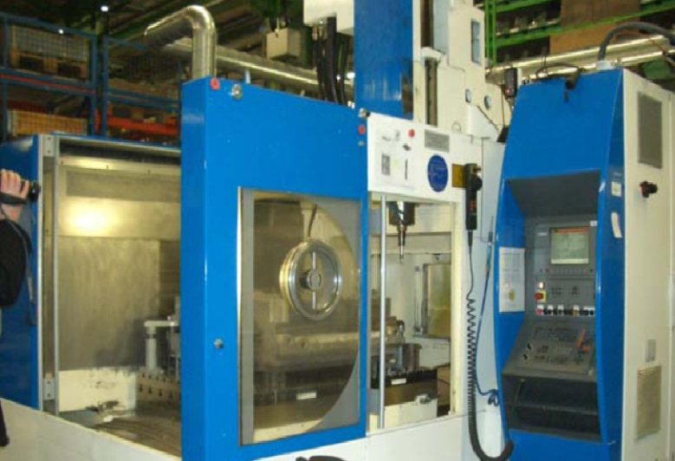
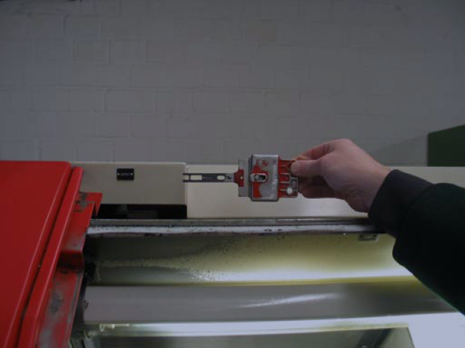
Definition of defeating
Defeating, or tampering, is defined in the HVBG Report as the rendering inoperative of protective devices with the result that a machine is used in a manner not intended by the designer or without the necessary safety measures.
Machine
Protective equipment
Machinery Directive
ISO 12100
ISO 14119
© Lüken/HVBG
Notes:
Before it can be addressed, the concept of "defeating" must first be defined. The Machinery Directive and the standards supporting it contain a range of requirements that must be met in order for a machine to operated without risk, including in foreseeable unusual situations. It must not be possible for protective equipment to be defeated by simple means. The HVBG Report, which will be presented later, summarizes the main requirements as follows:
Defeating is the rendering inoperative of protective devices with the result that a machine is used in a manner not intended by the designer or without the necessary safety measures.
Two points should be considered regarding this definition:
1) The means used to defeat the protective equipment are irrelevant in this context.
2) All necessary manual interventions in all operating modes of the machine must be considered.
On the left, we see a machine tool with a safety door open. On the right, we see a protective device on another machine that has been defeated. In this case, the actuator of a position switch has been unscrewed and inserted loose into the switch. This enabled the machine to be operated with the safety door open.

Slide 3
Examples of protective devices that have been defeated
Disconnected actuator with chain
Key-operated switch used for bridging
© Lüken/HVBG
© Apfeld/IFA
Roller switch, tied up
Roller switch, disconnected
© Pallowski/BG RCI
© Pallowski/BG RCI
Notes:
Further examples can be seen here of how protective equipment is defeated and thus rendered ineffective. This enabled the machines in question to be operated at a considerably higher risk to the operating personnel.
Top left: as shown on Slide 3, an actuator can be seen here that has been disconnected from the machine housing and inserted loose into the switch. The effort has even been taken to attach a chain to the actuator, probably in order for it to be stored neatly.
Top right: considerable effort has been taken to install a key-operated switch. This enables a protective device such as a position switch to be bridged and deactivated simply by the turn of a key. Instead of being stored securely, the key has been left in the lock with the protective device permanently bridged.
Bottom left: a moveable guard would normally be monitored by a roller switch. When the guard is closed, the black roller on the right in the orange part is pressed towards the switch in the grey part, thereby actuating the switch. In order to simulate a closed guard, the roller has been fixed to the switch in this case with tape or a cable tie. This can be achieved quickly and easily.
Bottom right: here, a similar roller switch has simply been removed. This also results in a closed guard being simulated to the machine control system.

Slide 4
HVBG Report: Defeating of protective equipment
Questionnaire campaign (940 respondents) for estimating the scale on which protective equipment is defeated
Questionnaire campaign (202 respondents) in companies concerning actual cases of defeating of protective equipment
Analysis of the reasons for defeating, considering human, technical and organizational aspects
Recommendations for action from the perspective of company operations, ergonomics, psychology and technology
DGUV Webcode: d6303
Notes:
Between 2003 and 2005, a study was conducted by the (then) Federation of institutions for statutory accident insurance and prevention (HVBG) into the defeating of protective equipment. The objective of the study was to estimate the scale of tampering with machinery, i.e. defeating of protective equipment. Reasons for defeating were analysed with the support of the machine operating personnel. A general questionnaire was used to record general assessments by approximately one thousand OSH experts, and a special questionnaire for detailed analysis of the specific incidence of defeating in plants, based upon a study of approximately 200 machines. The project team analysed the reasons for defeating on the personal, technical and organizational levels. The analyses in turn led to recommendations for systematic action to prevent defeating in consideration of psychological, ergonomic, organizational and technical aspects. This was accompanied by publication of the report described here, which is available (in German) from the DGUV in PDF format under Webcode d6303.
The report concluded that tampering with machinery had not been addressed adequately in the past in the context of occupational safety and health. For the purpose of illustration, the report described two specific examples of the defeating of protective equipment in plants, and discussed specific solutions for their avoidance. Finally, the study described the responsibility and liability for machinery that has been tampered with. Six articles from industry reflect the results of the study from the viewpoints of a machinery manufacturer, a number of manufacturers of protective equipment, and two operators of machinery: one medium-sized and one large company.

Slide 5
Estimation of defeating in Germany *
* Survey conducted in 2004/2005
Experts estimate that a quarter of all occupational accidents are caused by the defeating of protective equipment
Number for which defeating can lead to accidents:
Number defeated:
100 given items of protective equipment
37
18
One company in three tolerates defeating
Notes:
The main estimations of just over a thousand OSH experts are presented here. In 2004 and 2005, the estimations were that around 37% of protective devices on stationary machines are defeated either temporarily or permanently. In around half of the cases – on 18% of the protective devices – defeating could lead to an accident. In the view of all questioned, around a quarter of all occupational accidents on machines can be attributed to the defeating of protective devices. The estimation that tampering/defeating is tolerated in around a third of all plants is particularly delicate.

Slide 6
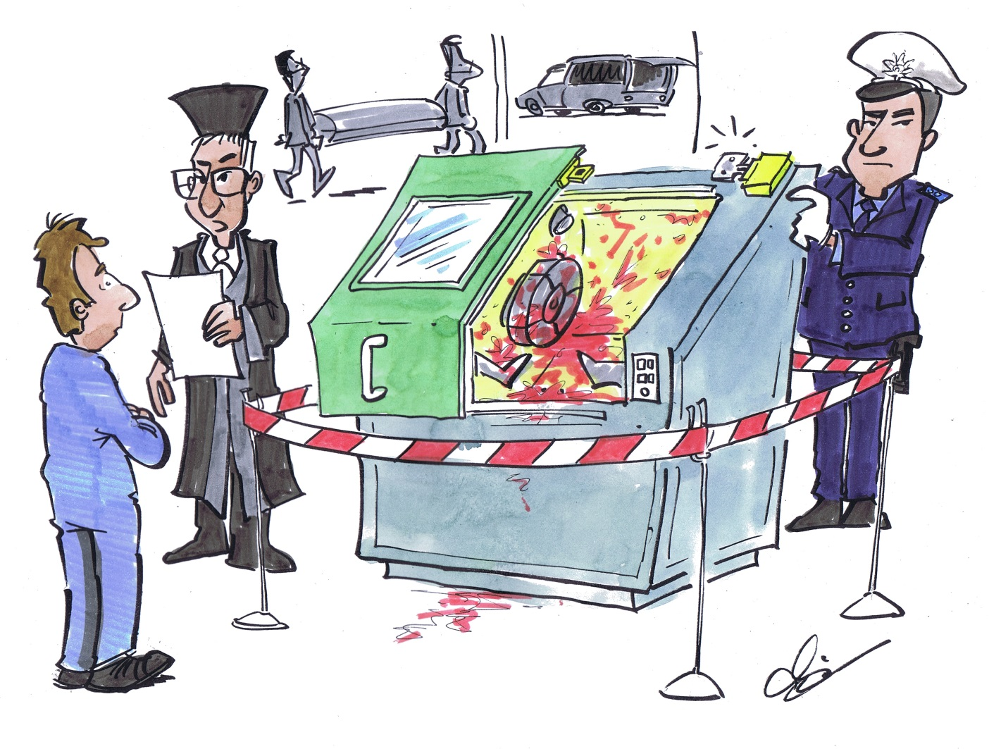
Estimated number of accidents per year on stationary machines
Germany:
10,000 accidents
8 deaths
© Michael Hüter
Notes:
To better illustrate the enormous harm caused to individuals and businesses, the estimations stated above can be extrapolated to the occupational accident statistics for stationary machines. For 2008 for example, this would mean that statistically, approximately 10,000 occupational accidents and eight fatalities were caused by the defeating of protective equipment.

Slide 7
Time and effort required for defeating
In 75% of cases, defeating requires no major effort, such as purchase/fabrication of a tool
In 60% of cases, defeating requires no more than 5 minutes
It can be reverted quickly in 90% of cases
5 minutes
Notes:
202 machines that had been tampered with were examined more closely in the study. It was found that electromechanical position switches on moving guards were defeated particularly frequently. For three-quarters of the cases studied, defeating required little time and effort. In 60% of cases, it required no more than five minutes. In 90% of cases, the manipulation could be reverted quickly. These results show that defeating is generally technically far too easy, and and can also be covered up.

Slide 8
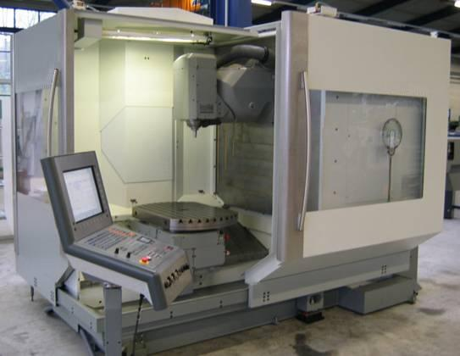
In what operating modes does defeating occur?
50% of cases occur in automatic mode, including adjustment, fault clearance, material feed
40% of cases occur in special operating modes: setup, programming and test operation, conversion, tooling, tool changing
© Lüken/HVBG
Frequently subject to defeating:
machining centres
Notes:
The study concludes that defeating of protective devices occurs in all operating modes. Automatic mode and setup were identified as blackspots. It is frequently the manual interventions required in these modes that are not well supported by the safety concept of the machine, such as adjustment and fault clearance in automatic mode.
On what machines did defeating occur particularly frequently in the random sample of the study? The bulk of the machines studied were machining centres, presses, and CNC lathes and milling machines. 58% of the machines of this type that were tampered with were manufactured in 1995 or later. Half of the machines bore CE marking. Defeating is not therefore a problem unique to older machines.

Slide 9
Reasons for defeating
Convenience
Simplification of work
Faster working
Increasing productivity
Time/performance pressure
Poor ergonomics
Facilitation of operating modes
Ignorance/underestimation of risks
Ignorance of hazards
Organizational obstructions
Other
940 respondents; multiple reasons possible
Notes:
During the study, the 940 experts were also asked to provide explanations for defeating. Their estimations are shown here. The reasons for and benefits of defeating are summarized: speeding up of machining processes, higher productivity, easier observation of processes, and simplified clearance of faults. In short: protective equipment is defeated in order to facilitate the work of the the operating personnel on poorly designed machines. On a third of the machines studied, working in special operating modes was not even possible without the protective equipment being defeated. In such cases, manufacturers have created a strong incentive for defeating as a result of unsuitable operating and safety concepts.

Slide 10
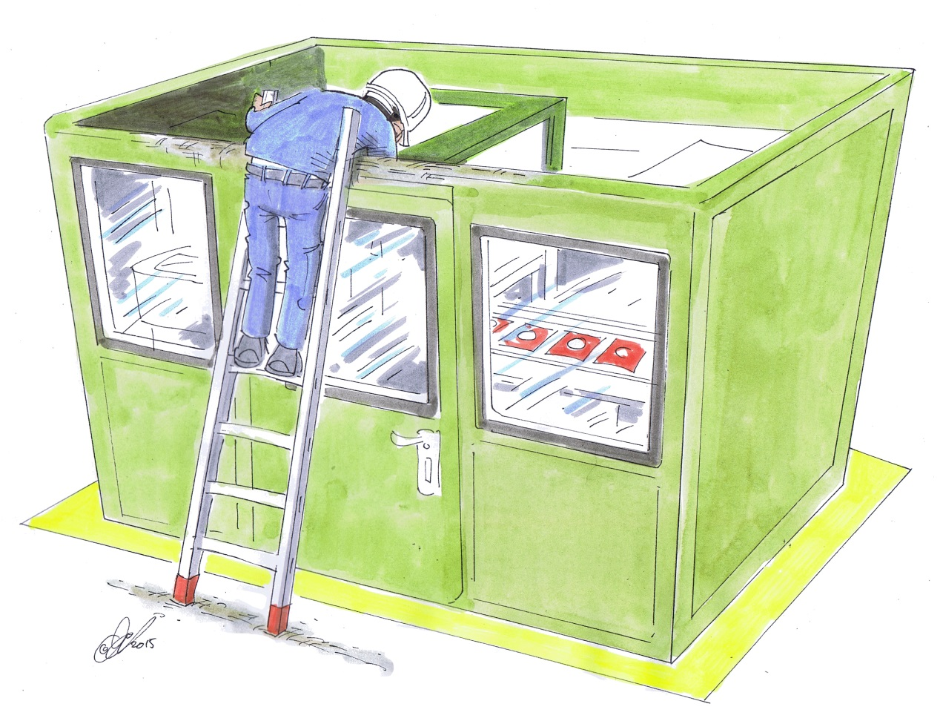
Incentive for defeating on hot-forming machines
Use of a ladder to circumvent the guard
Reason: time savings
© Michael Hüter
Notes:
Setting the punch stroke with the guard interlocked is very time-consuming, since the result of a change in setting cannot be assessed until a stationary state has been reached (in particular, the "working temperature" of the film being processed). When the safety door is opened, the stationary state of the film modifies the key operating parameters (the film generally cools down). Only once several punching strokes have been completed can the change in setting be assessed.
For this reason, setup on the machine shown was performed "from above": a ladder was used to reach down from over the guard (identifiable by the bare metal) in order to perform setup without the guard having to be opened. This enabled the result of the setting (seating of the almost fully punched part on the base film) to be inspected immediately after punching.

Slide 11
Machines presenting an incentive for defeating: examples
Winding machines
Starting
Sampling
Hot-forming machines
Adjustment of the punch stroke
Calendering machine
Manual cleaning of the rollers during operation
Pullers on extrusion lines
Starting and reorientation of profiles
Notes:
The list shows machines falling within the responsibility of the BGRCI and on which defeating has been observed. Owing to the large number of cases that have become known, it can be assumed that machines of this type constitute a blackspot. Robust studies are however not available.
On winding machines, starting presents a problem, as does sampling, since this process can generally be performed only with the machine running. The relevant standard, EN 13418:2010, describes only protective equipment that halts the entire winding machine. Under this safety concept, the manual operations referred to above are possible only whilst the machine is stationary. The consequence is manipulation of the machine. The Chemicals expert committee (FA CH) has therefore developed alternative safety concepts that have since been adopted by all major German manufacturers.
On calendering machines, caked deposits must often be removed manually (for example with wooden scrapers) whilst the machine is running (the calendering machine is often interlinked with other machines on a line for producing continuous material). A safety concept for this scenario can be found in the collection of examples.
On pullers, the profile may have to be rotated around its axis during starting. This is possible only in proximity to the intake gap. For this purpose, the interlocking guards on the intake side must be deactivated. Internal, local protective devices (such as interlocked suspended flaps located in front of the intake gap) are then activated.

Slide 12
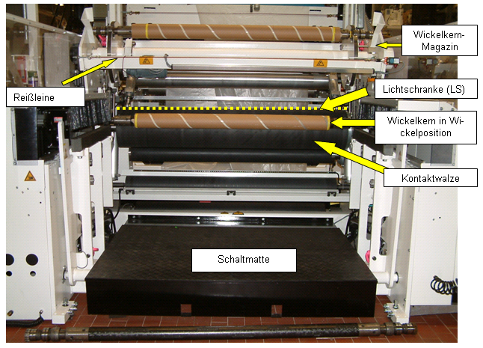
Surface winder without incentive for defeating
Sampling with the winder running:
Light barrier active only when the pressure-sensitive mat is stepped on
Safety function:
Withdrawal of the contact roller
© Pallowski/BG RCI
Notes:
In order for a sample to be taken (the sample must be taken just short of the winding point, in order to reflect all the properties of the film) with the winder running, the light barrier safeguarding the winding gap is activated when the pressure-sensitive mat is stepped on (a light barrier in permanent operation may lead to faults, caused for example by turning over of the film). The pressure-sensitive mat interrupts other hazardous movements (such as film-cutting equipment).

Slide 13
Detection of protective devices that have been defeated Examples
Function test
Opening of a safety door must bring about the safe state of the machine
Release of an enabling button (e.g. during setup mode) must bring about the safe state of the machine
Survey of the operating personnel
Is the protective equipment a hindrance during work?
Notes:
Assuming that the protective equipment has not been defeated, a function test leads to the machine being halted. The function test cannot therefore always be performed. Some forms of defeating cannot be detected in any other way, however, such as tampering with the wiring of position switches or changes to the programming of safety-related controls (safety PLCs, safety switchgear, etc.).
If protective devices are described by operating personnel as a hindrance, it is only a matter of time before they are defeated. The manipulation may also be reverted for the duration of a visit by a labour inspector. In such cases, too, it is worthwhile conducting or organizing consultation on improvements to the safety concept.

Slide 14
Detection of protective devices that have been defeated Examples
Visual inspection
Are shrouds, protective fences, etc. damaged, or have they been removed?
Does the labelling of key-operated switches suggest that they have been defeated?
Have switches/actuators been disconnected or damaged? Have they been wrapped with tape?
Is an actuator permanently inserted into the position switch?
Is the door only leaning to, but the actuator inserted into the switch?
Notes:
Mechanical modifications are generally relatively easily detected. See also the images on Slide 4.

Slide 15
Measures taken by the labour inspector
Identifying the reason: can the reason be eliminated?
Advising operators how the defeating of protective equipment can be avoided
According to the risk:
Directive is to be executed immediately
Normal directive
Inspection report
Attention is drawn to violation of the German Ordinance on industrial safety and health
Employer's duties
Employee's duties
Monitoring implementation
Further information: www.stop-defeating.org
Notes:
Defeating can be prevented for good only if the incentive for it is removed. For this purpose, the operator generally requires support with modifying the working process, the machine, etc. It should also be mentioned at this point that the lowest possible incentive for defeating protective equipment should be a consideration in the decision to purchase a particular machine (refer to the checklist for machine purchases at www.stop-defeating.org).
The directives issued should be commensurate with the risk.
Operators are often not aware that the defeating of protective equipment is illegal, and pointing this out is advantageous.
Implementation of the measures should be checked.

Slide 16
Pooling of experience between participants
What examples of defeating have you already witnessed?
What do you suspect were the reasons?
How could the specific incentive to defeat protective equipment be eliminated?
etc.
Notes:
Once the seminar participants have been inspired by a number of negative examples of incentives for defeating, they should make contributions of their own with reference to the slide. Prompted by these questions, they should report on cases of defeating that they have witnessed themselves. In each case, the reasons for defeating, i.e. the benefits of it, should be scrutinized. When the benefit has been identified, the participants should be prompted to discuss alternative solutions for safety concepts by which the incentives for defeating can be eliminated.

Slide 17
Legal situation
Responsibility:
Machine manufacturer
Responsibility:
Machine operator
Placing on the market
/
Design
Operation
Life cycle
Notes:
The machine manufacturer is responsible for the safety of the machine design up to commissioning and handover of the machine to the operator.
The operator is responsible for safe operation of the machine.

Slide 18
Legal situation of the machine manufacturer
9th Ordinance under the German equipment and product safety act (9th GPSGV)
Notes:
In Germany, the Machinery Directive has legal force through the 9th Ordinance under the German equipment and product safety act.
The machinery manufacturer thus has a legal obligation to observe the requirements of the Machinery Directive. This includes considering "reasonably foreseeable misuse of the machine". When protective equipment obstructs operation, or necessary operating modes are not provided, it is foreseeable that protective equipment will be defeated. Where this is the case, the machinery manufacturer must take appropriate measures, such as by:
Reducing the incentive to defeat protective equipment
Providing all necessary operating modes
Taking measures to make the defeating of protective equipment more difficult and more easily detectable (including by placing the machine in the safe state)

Slide 19
Legal situation of the machine operator
German Ordinance on industrial safety and health
The employer must ensure that the required protective or safety equipment cannot easily be defeated or bypassed
Notes:
In Germany, the Use of Work Equipment Directive has legal force through the corresponding German ordinance.
The machinery manufacturer thus has a legal obligation to observe the requirements of the directive. This includes using the machine in conjunction with its protective equipment.
Note: should he modify the machine, the operator may soon find himself becoming a manufacturer and having to demonstrate the machine's compliance with the Machinery Directive again.

Slide 20
Accident at Hero-Glas
Trainee dies as a result of defeated protective equipment
Two directors are convicted (with prejudice): manslaughter, 6-month suspended sentence, €100,000 fine
Fines fur further directors, shift manager, maintenance manager
Labour inspectorate official fined €9,000 for attempted cover-up http://www.ga-online.de/-news/artikel/120962/Hero-Glas-Urteile-sind-doch-rechtskraeftig
Notes:
Mirco Moormann, General-Anzeiger, 25.2.2014
The defence team of the directors of Hero-Glas in Dersum and of the maintenance manager have withdrawn their appeal. The parents of the trainee who was killed are now demanding damages for pain and suffering.
Dersum/Papenburg: the ruling by the Osnabrück regional court on 20 September of last year against five managers at Hero-Glas in Dersum and against an official from the labour inspectorate with regard to a fatal accident is now without prejudice. This was announced by the court on Monday. The defence team of the three directors and of the inspection manager, who had called in their pleadings for their clients to be acquitted, have now withdrawn their appeals. In response, the public prosecutor, who had also appealed for higher sentences for the production manager, the maintenance manager, the official from the labour inspectorate and the director Heinrich R., also withdrew his appeals.
Two directors have been awarded suspended prison sentences of six months for the criminally negligent manslaughter of a trainee. They have also each been fined €100,000. The regional court took the view that the light barrier fitted to the glass-grinding machine had been removed at the instigation of the younger director in order to increase productivity. This safety device, which interrupts the grinding process as soon as a person enters the working area, would have prevented the fatal occupational accident – had it not been removed. As a result, a 19-year-old trainee died in July 2010 as he leant into the machine on which he was working and was trapped in it, killing him. The older of the two directors had signed the training contract and was therefore responsible for the trainee's well-being, but did not concern himself adequately with it. Further fines were imposed upon the third director and upon the shift manager and maintenance manager. The official from the labour inspectorate was fined €9,000 for attempting to pervert the course of justice. He had tried to cover up the unsafe state of the machine.
The matter is still not over, however, since the parents of the dead trainee have now launched civil proceedings in which they are demanding compensation for pain and suffering from the individuals responsible. The death of the trainee had severe mental and physical consequences for the trainee's father, who is demanding damages of at least €30,000 for pain and suffering. In a parallel suit, the trainee's mother is demanding damages for pain and suffering of at least €50,000, together with further compensation owing to her inability to run the household for health reasons.

Slide 21
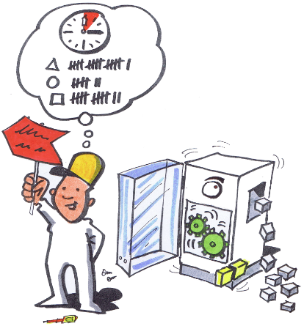
Commissioning
Purchasing
Setup
Sales
Operation
Design
Troubleshooting
Defeating
© Schmid Riedmann & Partner
© Michael Hüter
Notes:
A number of persons and functions are involved in the life cycle of a machine. Each of these has their own limited perspective, and different objectives. The defeating of protective equipment is not called into question; people have become used to it. Designers are therefore unaware of criticism of machines that present a high incentive for the defeating of protective equipment, or cannot otherwise be operated. All parties involved are happy, and no reason exists for the machine to be improved.
The designer has only the machine's functionality in mind; protective equipment is added as an afterthought, and conflicts with the machine's operation.
The sales personnel have their sights firmly on their sales targets, and may even sell machines that are not suitable.
The purchaser procures machines that are suitable from a financial and technical perspective; the incentive to tamper with them is not examined.
During commissioning, protective equipment may not yet be ready for operation, or may have to be deactivated. Special measures must be taken.
During setup, machine movements must frequently be performed with the safety doors open. If a suitable operating mode is not available, the protective equipment is simply defeated.
During operation, production quantities and cycle times are the key aspect. If protective equipment is a hindrance, it is simply defeated.
The machine must often be running during troubleshooting. If protective equipment is a hindrance, it is simply defeated.
In short: everyone is happy, and the defeating of protective equipment is a good thing. A vicious circle.

Slide 22
Break the vicious circle.
Commissioning
But how?
Raise awareness of the problem
Make information available
Provide design examples
Provide guidance documents
Offer tools
Consider the aspect of defeating in standards
etc.
Purchasing
Setup
Sales
Operation
Design
Troubleshooting
Defeating
© Schmid Riedmann & Partner
Notes:
To break the vicious circle, those involved must be made aware of the issue of defeated protective equipment. Appropriate information must be provided. Guides should be offered that describe how the defeating of protective equipment can be avoided, and assistance provided.

Slide 23
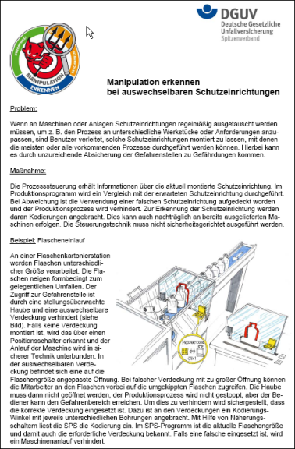
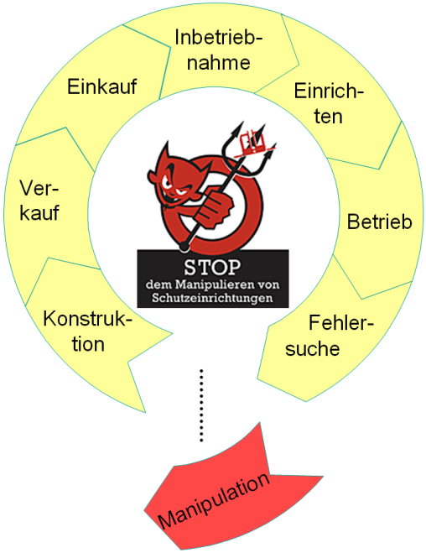
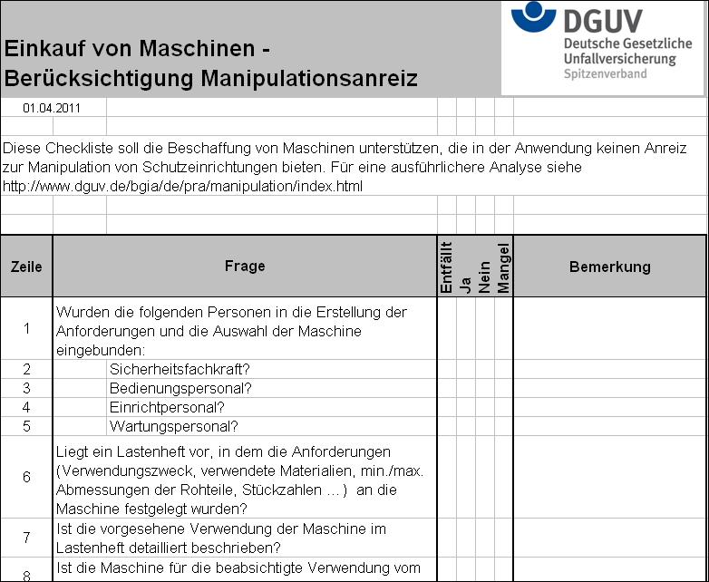
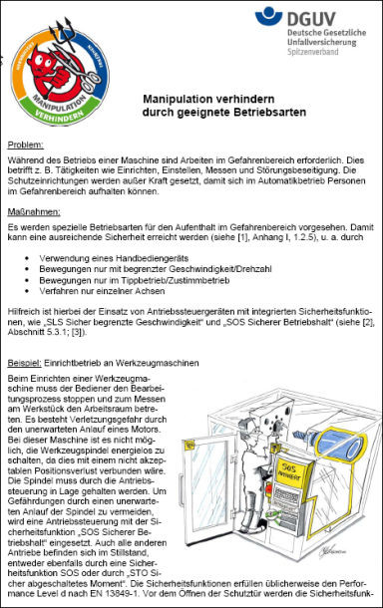
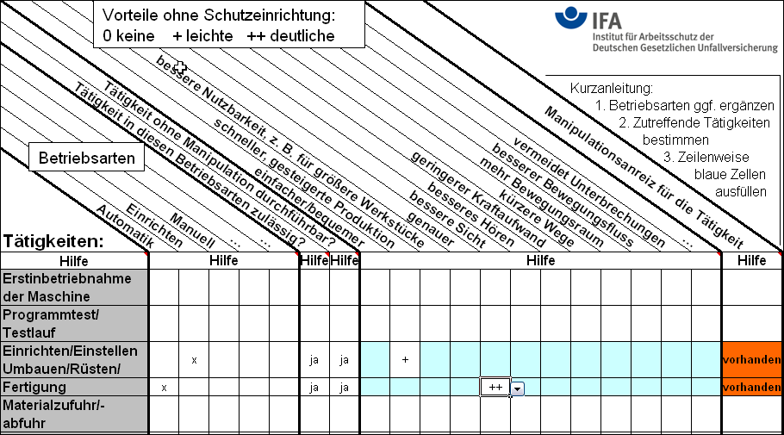
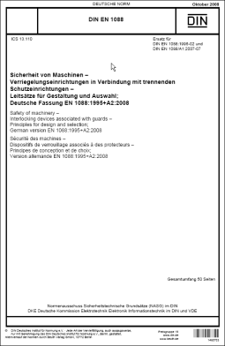
Break the vicious circle.
© Schmid Riedmann & Partner
© Michael Hüter
Notes:
From left to right:
2 design examples
The ISO 14119 standard, Safety of machinery – Interlocking devices associated with guards, contains a wealth of measures for reducing the defeating of protective equipment
Website: www.stop-defeating.org
Chart for identifying the incentive to defeat protective equipment
Purchasing of machinery – consideration of the incentive to defeat protective equipment

Slide 24
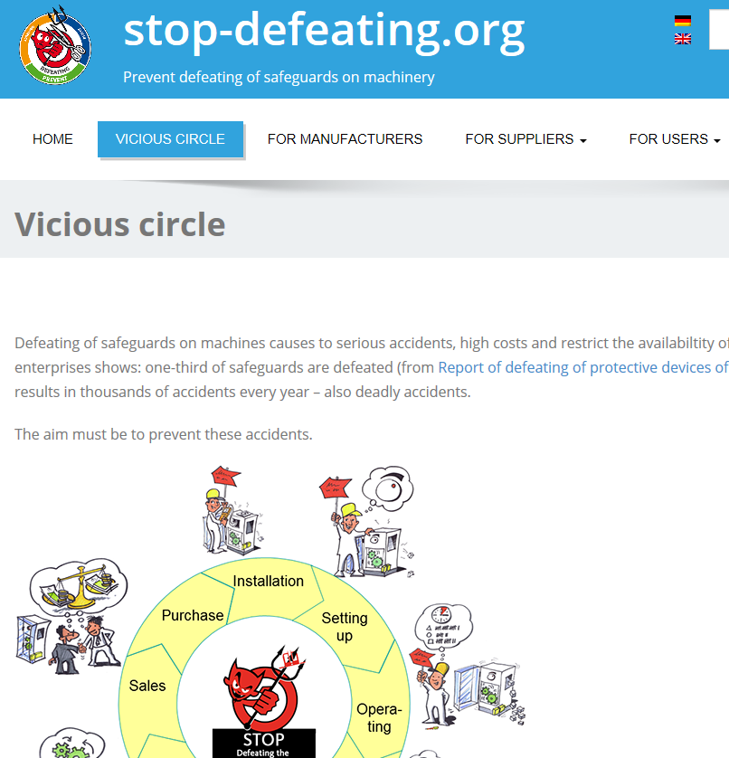
Notes:
The website is aimed at manufacturers, dealers and operators of machinery.
It is maintained by the International Social Security Organization (ISSA), with the support of the German Social Accident Insurance Institutions and the DGUV.

Slide 25
Notes:
A five-step procedure for preventing defeating is described for:
Manufacturers: for machines that have already been delivered, and for new products
Dealers
Operators: for machines that are already in use and have been manipulated, and for new purchases

Slide 26
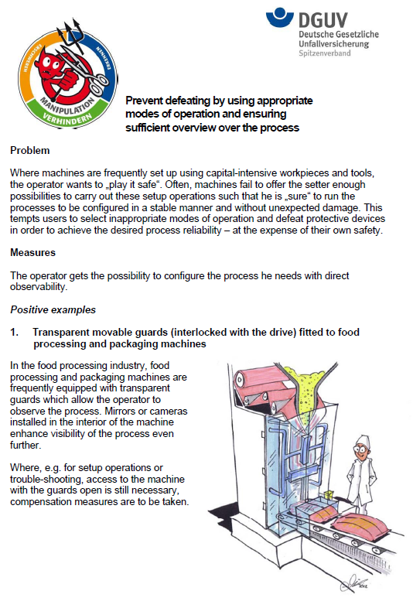
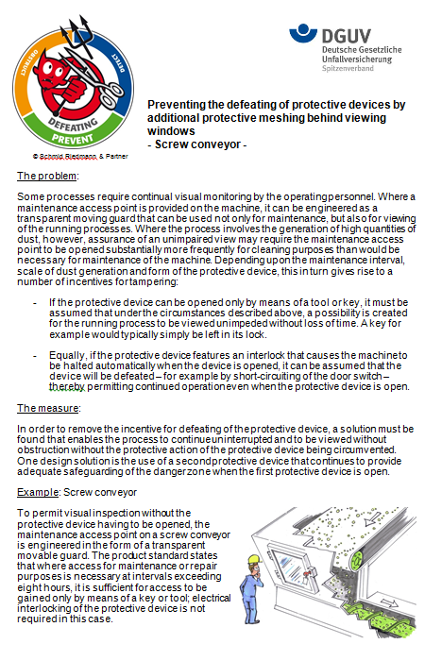
© Schmid Riedmann & Partner
Notes:
The section on practical assistance provides examples of good design for certain tasks. These can be downloaded free of charge. The aim of the examples is:
To prevent protective equipment from being defeated (for example because the protective equipment is not a hindrance and does not therefore give rise to an incentive to defeat it)
To make the defeating of preventive equipment more difficult (drilled-out screws in the image: the actuator of a position switch cannot simply be unscrewed and inserted into the switch)
To detect the defeating of protective equipment (and then to bring about the safe state)

Slide 27
Would you like to submit contributions?
Notes:
The editorial team welcomes contributions on the topic of the defeating of protective equipment. Possible contributions include reports of experience, suggestions, ideas, etc.

Slide 28
Source:
German Social Accident Insurance (DGUV)
Preventing defeating of protective devices on machinery –
tuition modules for accident prevention
On the Internet at: http://www.stop-defeating.org/
(last updated: 30.03.2016)
Edited/modified/restructured by: …………..

