Slide 1
Preventing defeating of protective devices on machinery
Module 2: Design of machines
Notes:
Three tuition modules on defeating are available:
Module 1: Introduction
Module 2: For manufacturers of machinery
Module 3: For operators of machinery

Slide 2
Conflicting priorities in design: communication
ProdSG
Manu-facturer
Operator
Requirements specification
Functional specification
BetrSichV
Notes:
Communication between manufacturer and operator, and knowledge of each other's concerns
In order to be able to develop the machine in line with the legal requirements, a manufacturer must be familiar not only with the operator's wishes, but also with his obligations. Equally, the operator must be familiar with the manufacturer's obligations, so as not to order anything outlandish. In order for manufacturer and operator to be adequately informed of each other's wishes and obligations, adequate communication must be assured between the two sides.
Conflicting priorities:
The wishes and obligations of the operator and the obligations of the manufacturer generally result in conflicting priorities that must be considered by the manufacturer, i.e. the designer. The following criteria for example may lead to conflicting priorities:
Occupational safety and health
Requirements imposed upon the operator by his operating personnel
Commissioning/sampling/acceptance at the operator's site
Official approval processes, for example concerning the environment, fire safety, etc.
etc.
The criteria show the importance of adequate communication between the operator and the manufacturer (designer).

Slide 3
Manufacturer and operator acting in concert
User's specifications
Manufacturer's information
[Image: to EN ISO 12100]
Notes:
For the designer, this communication process is already described in EN ISO 12100. It is important for the specifications made by the user (including his legal obligations) to be known.

Slide 4
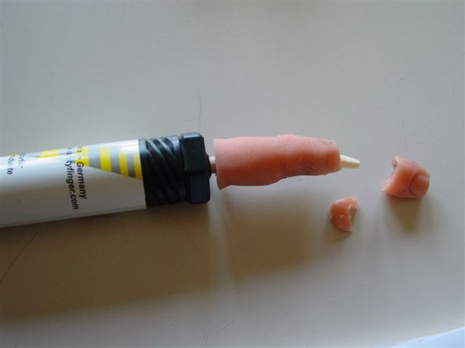
How much is it worth to defeat protective equipment?
(Lack of) safety for the operating personnel?
Ease of operation of the machine?
(Un)defined machine states?
Faster work?
Higher profits?
© C. Preusse/BGHM
Notes:
This slide is intended to prompt a brief discussion of the advantages and disadvantages of defeating protective equipment.
It soon becomes apparent that none of the points listed has a positive effect. Time savings are always stated as a reason for defeating, but a mature operating and safety concept generally results in even greater time savings.

Slide 5
'Where there's a will, there's a way'
Adapting work tasks to the concept of the machine
Working through tasks as a basis for risk assessment
Keep it simple: secondary tasks should be performed away from the machine
Automatic functions: having them isn't enough – they must also be used
= loss of time = uneconomic machine
Incentives for defeating
Notes:
Where the will exists to eliminate the defeating of protective equipment, the application of EN ISO 12100 can be very beneficial.
This requires:
Satisfaction of the technical requirements (this costs money, but results in considerable savings during production)
Satisfaction of the organizational requirements (the strategy must be followed, on all hierarchical levels)
Personal preferences may have to be reconsidered

Slide 6
Example: flange machining
Primary processing time: Primary processing time: 865 minutes 620 minutes
Costs: €1,081.50 Costs: €849.00
60% higher utilization
Notes:
Real-case example from production in a small/medium-sized company (50 employees) that planned the processes in advance and implements planning thoroughly:
The flange is from an item of earthmoving equipment (an excavator) and must be relief-milled for repair.
The machine used for automatic machining does not provide suitable protective equipment for setup in this case. Defeating of the protective equipment can therefore be anticipated.
The manufacturer modifies his operations and uses equipment that enables him to perform setup primarily beforehand and outside the milling machine.
This has the added effect of increasing utilization of the milling machine. The equipment for external setup costs approximately €15,000.
On the left, the example without simultaneous processing during the primary processing time (the primary processing time is the time during which the machine is occupied, for whatever purpose); on the right, the example with parallel operation during the primary processing time.
Not shaded: auxiliary tasks not relevant to the primary processing time.
Shaded: the task concerned is performed on the machine, i.e. it occupies it.
Tooling time: time during which the tool/workpiece is being fitted to the machine, positioned and measured, and further auxiliary tasks are performed that can be performed only on the machine.
Machining requires:
A program to be written for the machine containing the individual machining steps
The milling tool to be assembled, where it comprises multiple components (as is often the case)
Performance checking of the tool (how far does it extend from the mounting into the machine)
Determining of the baseline point of the workpiece, since the machine program otherwise has no geometrical reference (the milling tool is moved whilst running towards a defined workpiece position until the milling tool cutters first make contact with the workpiece, producing a scratching noise)
A pilot component must first be produced: this is generally measured carefully following machining
Deburring: burrs are often left on the workpiece, and must be removed

Slide 7
Availability
Planned tasks increase availability
Creating operating modes increases availability
Accidents reduce availability
Only by considering all phases of the life cycle during design is a good result reached
Notes:
A further point from EN ISO 12100:
Consideration of all phases of the life cycle; creation of suitable operating modes. When a work task is to be performed, a safe operating mode is one way of meeting the technical requirements for its completion. This is planned, and thus increases availability.

Slide 8
Identification of customer requirements
What is to be produced?
What type of machine is needed?
What requirements must be met by the machine?
What tasks must be provided?
Setup, cleaning, troubleshooting, fault clearance, maintenance, etc.
Notes:
The overview shows a selection of relevant questions that the operator (customer) must ask himself and that he must answer – including what persons within his operation are to be involved in this process. The presentation should not be considered exhaustive.

Slide 9
Identification of customer requirements
What construction requirements must be met (e.g. by the building, ventilation, waste air exhaust)?
What requirements must be met by the personnel?
Skills, capacity
What legal requirements must be satisfied by the machine?
What is the life cycle of the machine?
Notes:
Overview (continued):
The overview shows a selection of relevant questions that the operator (customer) must ask himself and that he must answer – including what persons within his operation are to be involved in this process. The presentation should not be considered exhaustive.

Slide 10
Persons involved
Senior management
General management
Technical/production management
Purchasing
OSH professional/safety delegate
Future operating personnel
Accident insurance institution
State OSH authorities
Notes:
These individuals must concern themselves with resolving the issues already referred to.
It is worth emphasizing at this point that the German Social Accident Insurance Institutions and the state labour inspectorates are important partners concerning safety and health issues.

Slide 11
Requirements specification
The conclusions relevant to the machine manufacturer should be summarized in a requirements specification.
The requirements specification is binding upon the manufacturer.
Notes:
Continuation and conclusion.

Slide 12
Risk assessment should begin during sales planning.
The customer's requirements specification must be available:
Intended use
Ambient conditions
Skills of the personnel
Testing and maintenance strategy
etc.
Based upon the requirements specification, the manufacturer produces the functional specification.
Notes:
The particular issue of communication:
The above criteria are reflected in the requirements specification and through it in the functional specification.

Slide 13
Requirements in the functional specification
Intended use
Foreseeable misuse
Knowledge required on the part of the operating personnel
Operating and safety concept
Maintenance strategy
Instruction handbook
Reaction of the machine to faults
etc.
Notes:
The particular issue of communication:
The above criteria are reflected in the requirements specification and through it in the functional specification.

Slide 14
Integration of the safety concept
Expertise and experience of the designer
Skills of the user
Observance of:
Three-step procedure to EN 12100
Three step method: technical measures to prevent the defeating of protective equipment
Selection of components
Control concept
Obtaining of further detailed information
Evaluation of the usability
etc.
Notes:
The requirement set out in the Machinery Directive that the necessary safety concept must be considered and design details brought into line with it at the design stage requires the designer to have sound expertise and considerable experience regarding the subsequent use of the machine by the operating personnel. It is therefore advisable for the knowledge held by the operating personnel to be considered during detailed design.
The skills of the operating personnel, which must be determined when the limits of the machine are determined, must be considered in particular in order for incentives for the defeating of protective equipment to be identified, and corresponding measures to prevent this to be specified.
The three-step procedure, which is stated in Annex I, Section 1.1.2 of the Machinery Directive as a principle of integration and is supported by EN 12100, must be followed during the design process. The procedure to be followed by the designer is as follows:
Eliminate or minimize risks
Take the necessary safety measures
Draw attention to residual risks
Likewise, the designer must consider the three-step procedure of technical measures to prevent the defeating of protective equipment:
Preventing defeating
Making defeating more difficult
Detecting defeating
In order for these requirements to be satisfied, it is very important that suitable protective equipment be selected. If protective equipment is selected that does not obstruct the operating process and that permits swift intervention and the immediate resumption of production when personnel have left the danger zone, the first main step towards avoiding the incentive for defeating has already been taken.
Selection of the most suitable components for interlocking guards (e.g. hinge safety switches or position switches with shrouded fitting) can be an effective way of making defeating more difficult.
A further possible measure is the use of control technology to monitor the switching signals from position switches. Should a working process require cyclical manual intervention in the danger zone, linking the contacts of position switches with the machine controller enables operation of the position switch to be monitored at each "restart", thereby enabling a switch that has been defeated to be detected.
Finally, assessment of the usability of the safety concept is also an important element by which possible incentives for defeating can be identified.

Slide 15
Three-step procedure: Technical measures to prevent the defeating of protective equipment
1.
2.
3.
© Schmid Riedmann & Partner
Notes:
The measures for the avoidance of defeating must be performed in the following order:
Avoidance of defeating by elimination of the incentive for it, i.e. the protective equipment does not present a hindrance
Presenting obstacles to defeating, for example by fitting position switches where they are inaccessible, or by using welding or bonding, for example, to fit them and their actuators so that they cannot be removed
Detection (by the control system) of defeating, and consequently prevention of the machine from operating. Example: on a bread slicer, a flap must be opened at regular intervals in order for the sliced bread to be removed. The control system monitors the position of the flap and expects regular opening/closing of the flap during operation. Should this cycle not be detected, the flap has been manipulated, and the control system shuts the machine down.

Slide 16
Incentives for the defeating of protective equipment
Work cannot be performed
No view of the work area
The process takes too long
Use is cumbersome
The work cannot be performed ergonomically
The safety concept is too susceptible to faults
The safety concept presents an obstruction to the clearance of faults
etc.
Notes:
These are generally the reasons for the defeating of an item of protective equipment. If they are considered during design, the incentives for defeating are also reduced to a minimum. It is not always possible to eliminate all incentives for defeating. Where the incentive cannot be eliminated, the only solution is to increase the effort required for it, or to exclude it almost completely by a carefully chosen control concept.

Slide 17
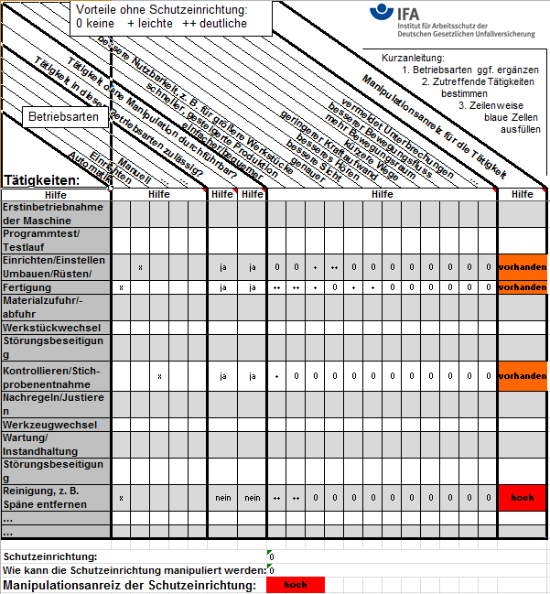
Assessment matrix of the incentive for defeating
Also available as an app
www.dguv.de, webcode: d3295
Notes:
Provide explanations of the assessment matrix.
(Refer to the IFA publication on the incentive to defeat protective devices on machinery, May 2011)

Slide 18
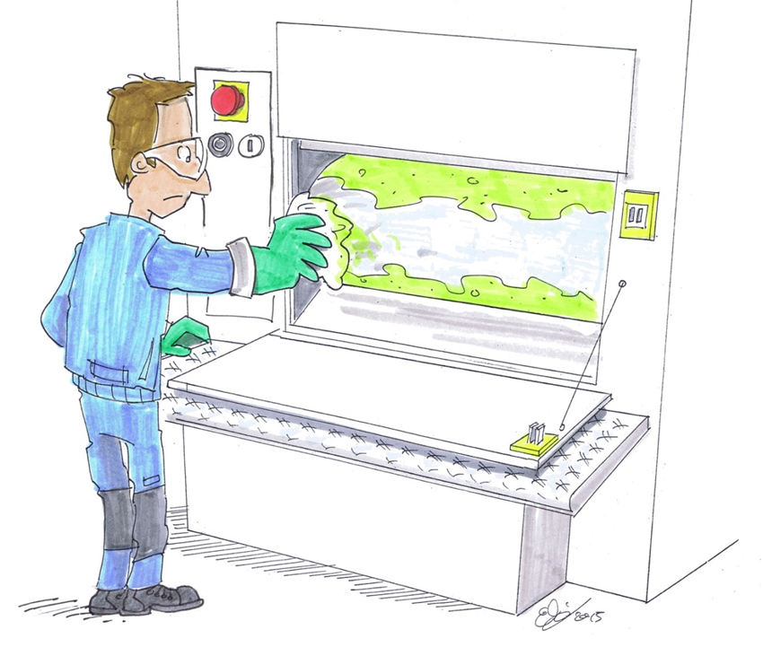
Example of a printing machine
The problem:
The roller must continue to turn during manual cleaning
© Michael Hüter
Notes:
The problem:
A worker must clean the pressure roller on a production line at regular intervals. For this purpose, he must approach the roller and clean it using a special cloth.
Access to the roller is possible only through an interlocked door/safety hood. Opening this protective device halts the production line.
Owing to the design of the machine, only a part of the roller can be cleaned at once.
The worker must therefore repeatedly leave the danger zone, briefly restart the production line from the control panel, and then return to the danger zone in order to clean the next part of the roller.

Slide 19
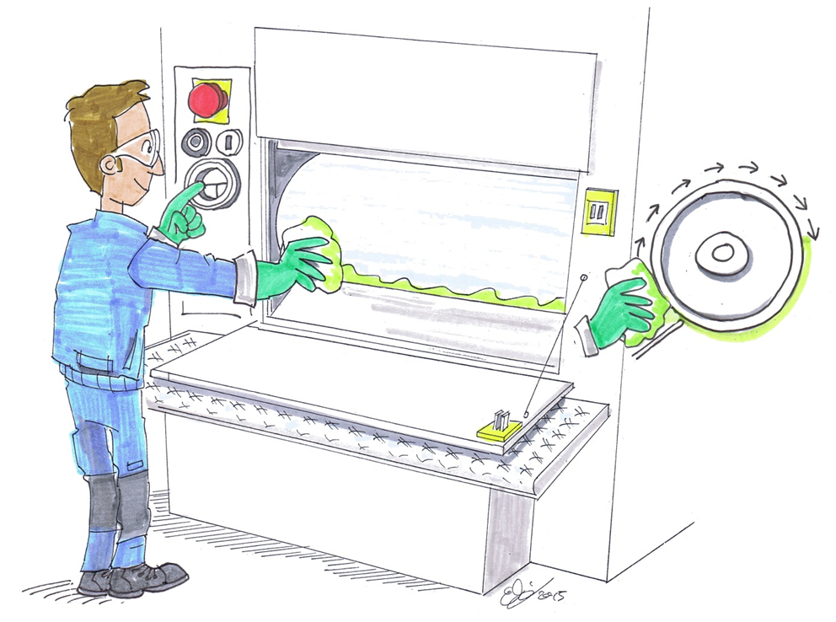
Example of a printing machine
The solution:
The incentive for defeating is reduced by an inch mode
© Michael Hüter
Notes:
The problem:
A worker must clean the pressure roller on a production line at regular intervals. For this purpose, he must approach the roller and clean it using a special cloth.
Access to the roller is possible only through an interlocked door/safety hood. Opening this protective device halts the production line.
Owing to the design of the machine, only a part of the roller can be cleaned at once.
The worker must therefore repeatedly leave the danger zone, briefly restart the production line from the control panel, and then return to the danger zone in order to clean the next part of the roller.

Slide 20
Source:
German Social Accident Insurance (DGUV)
Preventing defeating of protective devices on machinery –
tuition modules for accident prevention
On the Internet at: http://www.stop-defeating.org/
(last updated: 30.03.2016)
Edited/modified/restructured by: …………..

