Slide 1
Preventing defeating of protective devices on machinery
Modul 3: Operation of machines
Notes:
Section 5 of the German Ordinance on industrial safety and health (BetrSichV) states that the machines made available by machine operators must be constructed in compliance with the Machinery Directive and must be suitable.
The following steps must therefore be taken preferably when a machine is made available, and otherwise when it is accepted (i.e. before it is tampered with), and at the latest when the defeating of protective equipment is observed.
Zielgruppe des Lehrmoduls
Maschinenbetreiber, incl. Einkäufer
Aufsichtspersonen der UVT
Safety delegates
OSH professionals
(students in higher education)
Learning targets
Following successful completion of the module, the course participants are to have acquired the following knowledge:
Recognition that ways exist for machinery to be operated without tampering and without additional expenditure
Identification in the procurement process of whether a machine on the market is proof against tampering
Use of the functional specification, which also addresses safety
Strategy permitting the detection of tampering (detection process)
Possible measures in the plant for avoidance of tampering in plant operations, and obligation for their use
Knowledge of operators' rights to redress against the manufacturer/distributor of a machine when it cannot be operated without the defeating of protective equipment
Knowledge of sources of assistance in resolving operational problems
Knowledge of forms of support available from the state authorities/statutory accident insurance institutions
Measures that may be taken by labour inspectors in companies

Slide 2
Purchasing process = safety-related communications loop
ProdSG
Manufacturer
Operator
Requirements specification
Functional specification
BetrSichV
Notes:
Cooperation between the manufacturer and the operator in a communication loop in the interests of mutual understanding.
Purchasing of a machine presenting no incentive for the defeating of protective equipment prevents equipment defeated in this way from being operated, and thus also prevents violation of the legislation, in the long term. The machine purchasing checklist supports the procurement process.

Slide 3
Purchase of machines with a low incentive/scope for defeating
Involvement of operating and maintenance personnel, OSH professional
Creation of a requirements specification
Are all intended tasks (operation, fault clearance, maintenance, cleaning, etc.) possible without protective equipment being defeated?
Is the machine suitable for its intended use?
Do the personnel possess the skills required to operate the machine?
etc.
Machine purchasing checklist:
http://www.stop-defeating.org/fur-betreiber/checkliste-maschineneinkauf/
Notes:
Machines should be purchased that present little or, ideally, no incentive for the defeating of protective equipment. This must be considered at the purchasing stage of the machine, since once the machine has been installed, the company must cope with its deficiencies for 20 years or more. In order to support purchasing, a checklist is therefore introduced here that supports the procurement of safe machines.

Slide 4
Procedure in the event of defeating being detected
Survey of the status quo, gathering of essential information
Investigation of causes during risk assessment
Definition of counter-measures
Implementation of the measures
Review of the efficacy
Notes:
Evaluation of the status quo:
In day-to-day company operations, individuals who may be affected – including managers – refuse to face the issue, since they would have to admit failings, and to having contributed to the reasons for defeating of the protective equipment.
However, when the case is made for usability to be improved and at the same time the level of safety to be retained or even improved, pressure can be brought to bear on all parties involved without apportionment of blame.

Slide 5
Step 1: Survey of the status quo
What equipment is defeated?
How is it defeated?
During what tasks does defeating occur?
Why is equipment defeated?
By whom is it defeated?
Is the machine still in the as-delivered condition?
Important: The task here is not that of finding a "guilty party".
Additional benefit: Greater ease of use and cost-effectiveness
Notes:
The reason why protective equipment is defeated is determined by the question "why". The answer in turn forms the starting-point for measures to reduce the incentive for defeating.

Slide 6
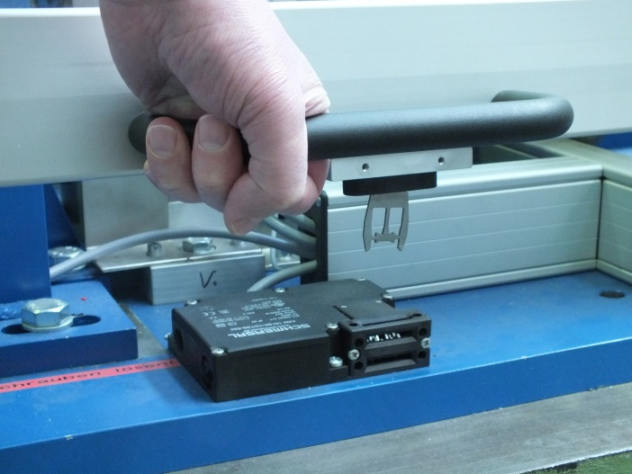
Step 2: Investigation of causes
Analysis and documentation:
Checklist for determining the reasons for defeating (see www.stop-defeating.org)
Important: No interrogation, no knock-out arguments
© Staffel/DGUV
Notes:
Step 2: Identifying reasons:
Why; what is not possible; what constraints are overcome by the defeating of protective equipment?
This should not take the form of an interrogation; at the same time however, no one should be able to talk themselves out of their responsibility. Phrases such as 'we've always done it like that' or 'there's no alternative in this case' must not be accepted, and must be scrutinized logically.

Slide 7
Step 3: Definition of counter-measures
Technical measures
Organizational measures
Personal measures
Notes:
Following the logical scrutiny of Step 2, this step concerns measures in accordance with TOP.
The individuals concerned frequently take the easy way out and are happy to agree to simple protective measures – knowing that they will again be able to defeat them. Such dishonest tactics must be recognized at this stage, and the individuals using them must be called out for them.
The measures taken must not give rise to restrictions in other areas, and may come at considerable financial cost. However, measures taken in a running system are always more costly than had they been implemented from the outset. See Slide 2: appropriate measures improve usability and therefore speed, saving valuable working time in operation (productivity is generally increased).

Slide 8
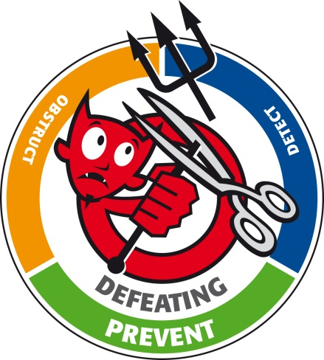
Step 3.1: Technical measures
Development of an alternative safety concept (ideally in conjunction with the manufacturer)
Three-step procedure: technical measures to prevent the defeating of protective equipment
Important: a risk assessment must be performed of the new safety concept
Notes:
Here, we consider who is responsible and where support can best be found.
Besides the manufacturer/supplier, sources of support include state bodies (the labour inspectorate), the statutory accident insurance institutions, and also the OSH professional and occupational physician. Improvement of a safety concept does not generally constitute a "substantial modification" of the machine.
The measures for the avoidance of defeating must be performed in the following order:
Avoidance of defeating by elimination of the incentive for it, i.e. the protective equipment does not present a hindrance
Presenting obstacles to defeating, for example by fitting position switches where they are inaccessible, or by using welding or bonding, for example, to fit them and their actuators so that they cannot be removed
Detection (by the control system) of defeating, and consequently prevention of the machine from operating. Example: on a bread slicer, a flap must be opened at regular intervals in order for the sliced bread to be removed. The control system monitors the position of the flap and expects regular opening/closing of the flap during operation. Should this cycle not be detected, the flap has been manipulated, and the control system shuts the machine down.

Slide 9
Step 3.2: Organizational measures (selection)
Definition of company guidelines ('defeating will not be tolerated')
Definition and implementation of procedures in response to violations of the guidelines
Installation of the process
Reporting of defeating
Identification of technical solutions
Step 3.3: Personal measures
Training
Provision of instruction
Notes:
It is not always possible for protective equipment to be designed such that little or no incentive exists for it to be defeated. It is therefore particularly important for personnel to be instructed appropriately and to be informed of the dangers presented by defeating. The defeating of protective equipment must not be tolerated by superiors, much less rewarded with praise for the time savings or the avoidance of interruptions to production.
Within companies, personal measures must be subordinate to organizational measures, and must be taken seriously by all superiors, including senior management.

Slide 10
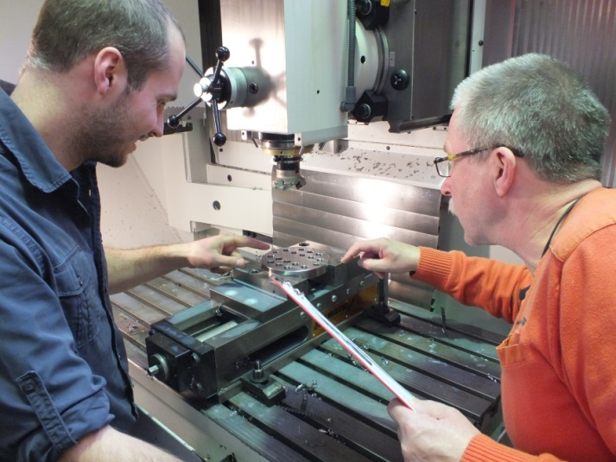
Step 4: Implementation of the measures
Appointment of responsible individuals
Documentation of the measures
Provision of instruction on changes
The safety concept must enjoy the operating personnel's acceptance. Therefore, provision of information on:
Process changes
Timing of the changes
Changes to working procedures
Responsible individuals
© Staffel/DGUV
Notes:
Measures should be implemented to a deadline. A schedule for implementation, applicable to all the parties involved, is therefore essential.
Acceptance should be polled in Steps 2 (consultation) and 3 (measures). This point is emphasized here because implementation deviating from the schedule may no longer meet with the acceptance of the personnel working on the machine.

Slide 11
Step 5: Review of the efficacy
Evaluation of the chosen solution in conjunction with the operator.
Definition of tests:
Random sampling
Repeat tests

Slide 12
Purpose: to break the vicious circle
Commissioning
Purchasing
Setup
Sales
Operation
Design
Troubleshooting
www.stop-defeating.org
Defeating
© Schmid Riedmann & Partner
Notes:
When the five steps presented here are followed, the vicious circle can be broken.
Reference to the "stop-defeating" website.
Explanation of the vicious circle:
The defeating of protective equipment is tolerated throughout the life cycle of the machine: no one complains and no one looks for solutions. The designer receives no feedback and is not called upon to design the machine in such a way that it presents no incentive for the defeating of protective equipment.

Slide 13
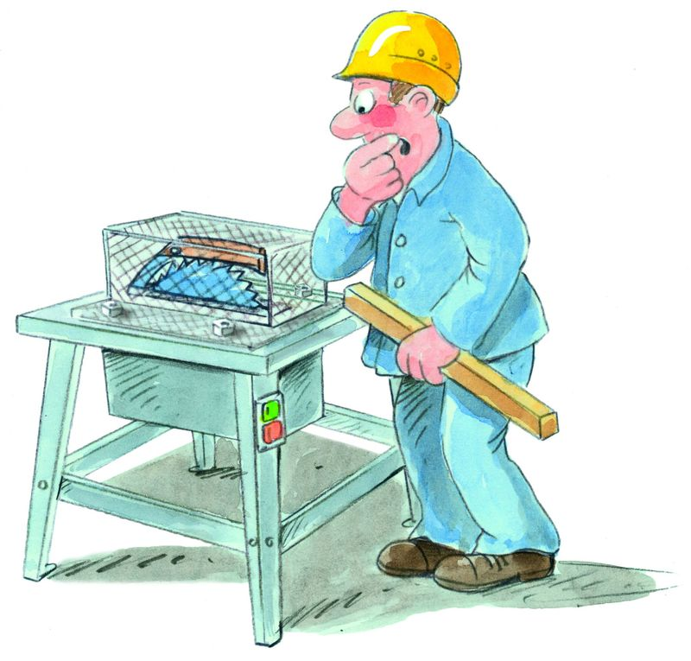
Real-case example of technical measures to prevent the defeating of protective equipment
© Bernhard Zerwann/zerwanndesign
Notes:
This part of the lecture is intended to describe how, by purchasing suitable work and protective equipment, operators can also keep the incentive to defeat the protective equipment very low. In specific cases, it may be appropriate to place higher demands on this equipment than those set out in the standards.
A comment – not entirely serious – on a circular saw:
The fixed guard, which can be opened only by means of a tool, provides 100% protection against cuts to the hands. The health and safety requirements of the Machinery Directive are therefore met. When a circular saw like this is supplied, it is obvious that the operator will manipulate the guard. He will remove it – in order to be able to perform sawing work.

Slide 14
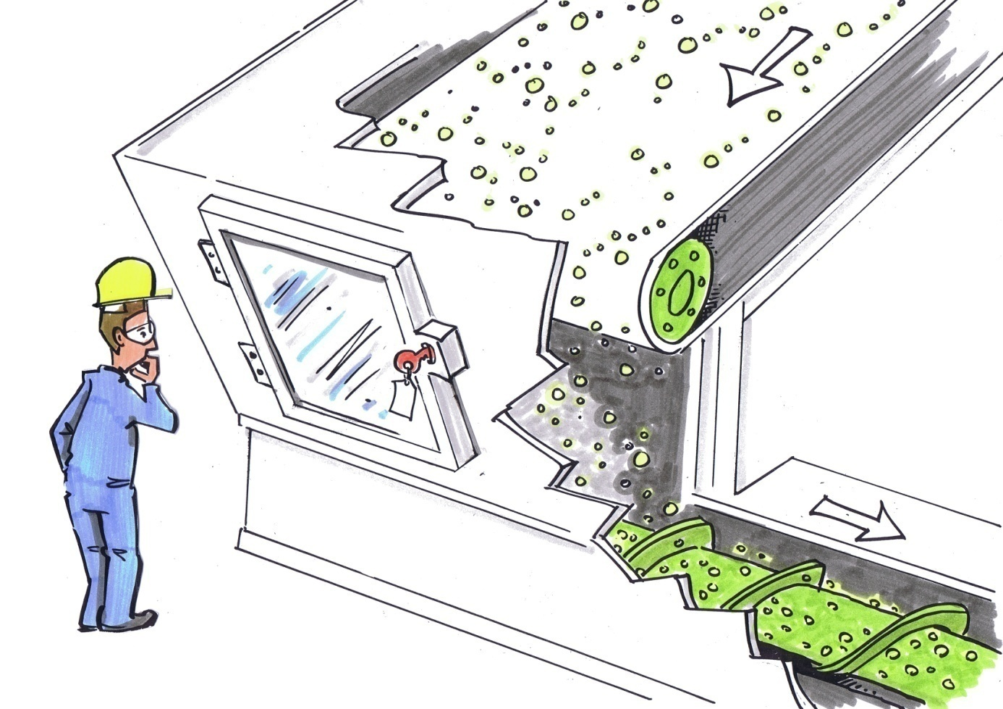
Example: screw conveyor
The problem:
Dust deposits on the viewing window obstruct the view of the process
© Michael Hüter
Notes:
The access opening has a viewing window that enables the process to be observed without opening the machine. The machine needs to be accessed for maintenance or repair purposes only at intervals of more than eight hours. The only stipulation is therefore that a key or a tool must be required for access. The standard does not stipulate electrical interlocking. Since gravity prevents the access door from remaining in the safe position when it is unlocked, this solution satisfies the standard in theory. However, when the viewing window is covered with dust, it must be assumed that the access opening presents a way of observing the process easily and without loss of time whilst the machine is running. It can therefore be expected that the key will be left in the lock so that the door can be opened quickly at any time. There is therefore an incentive for manipulation, depending upon the type of material being transported.

Slide 15
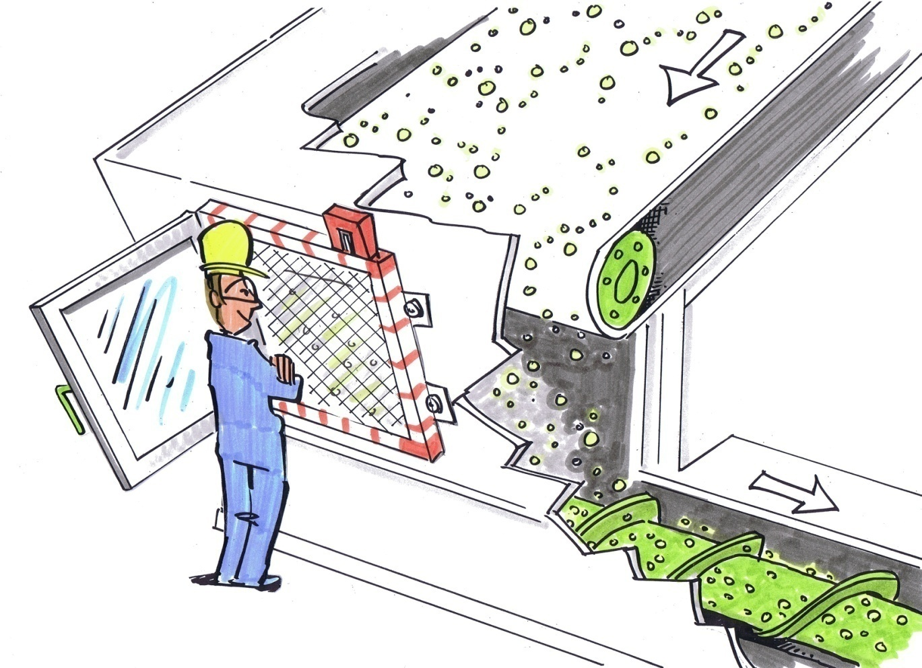
Design measures for eliminating incentives to defeat protective equipment
The solution:
An additional, interlocked mesh was fitted
© Michael Hüter
Notes:
The following solution reduces the incentive to defeat the protective device to a minimum: a mesh with an electrical interlock is fitted behind the access door (which may or may not contain a window), enabling the area to be viewed whilst the machine is running. Should access be required, opening the mesh causes the dangerous movements to be brought to a forced halt. This arrangement has disadvantages neither for the workflow, nor for maintenance or repair.

Slide 16
Source:
German Social Accident Insurance (DGUV)
Preventing defeating of protective devices on machinery –
tuition modules for accident prevention
On the Internet at: http://www.stop-defeating.org/
(last updated: 30.03.2016)
Edited/modified/restructured by: …………..

