Slide 1
Preventing the defeating of safeguards on machines Module 4: Design examples
Notes:
This module presents the best-practice examples found on the www.stop-defeating.org website.
The structure of the examples is as follows: the first slide contains a general description (in the notes) of situations that are known to lead frequently to defeating. The problem is described with reference to a specific example. The second slide contains a general description of effective measures and actual implementation with reference to the example previously described.
The examples are described to the participants in the presentation only by means of bullet points and images. These may not suffice on their own to explain the issues adequately. Lecturers are advised to have familiarized themselves completely with the issues in advance with reference to the notes.
The lecturer can either show the examples from the field directly, or develop possible solutions to the problems shown (on the second page for each example) together with the lecture participants.
Slide 6, which contains a table summarizing the three approaches to the avoidance of defeating, contains links to the corresponding examples. A link back to Slide 6 is provided at the end of each example.

Slide 2
3-step method for the prevention of defeating:
© Schmid Riedmann & Partner
Notes:
Briefly introduce the concept of preventing defeating, based upon the three steps of:
Avoiding the (incentive for) defeating
Obstructing defeating
Detecting defeating
It is not necessary to discuss these in depth at this stage; what is meant by each step will be explained in the examples on the following slides.

Slide 3
3-step method for the prevention of defeating:
3-step method for the prevention of defeating:
Protective equipment does not obstruct the production flow
Protective equipment does not obstruct
Protective equipment does not obstruct the production flow
Prevent incentives for defeating
Prevent incentives for defeating
Reliable processes thanks to:
High-quality tool elements
Homogeneous materials
Decoupling of processes prone to faults
Preventive maintenance
etc.
Straightforward
resumption of
operation
following stoppage
of the process
Easy handling
of protective equipment
Easy handling of protective equipment
Reliable processes
Easy handling
Straightforward resumption of operation
following stoppage of the process
Reliable processes thanks to:
High-quality tool elements
Homogeneous materials
Decoupling of processes prone to faults
Preventive maintenance
etc.
Straightforward resumption
of operation
Sufficiently long process cycle intervals with specification of the time for fault rectification
Sufficiently long process cycle intervals
with specified time for fault rectification
Sufficiently long process cycle intervals
Safety concept permits straightforward fault rectification
Process observation with the protective equipment closed
Safety concept permits straightforward fault rectification
Straightforward
fault rectification
Safe drive control
Process observation with the protective equipment closed
Safe drive control
Process observation with the protective equipment closed
Safe drive control
Notes:
This slide and the two that follow it have the purpose of addressing each of the three steps for the avoidance of defeating in greater detail.
Descriptors in the ovals show at a glance possible options by which the objective of each step can be attained. The options are not exhaustive; many others are possible.
The descriptors are to be expanded upon in discussions with the lecture participants during the lecture. Individual terms can be highlighted by clicking and expanded upon with further explanations. A second click closes the ovals again.
A reference to the www.stop-defeating.org website (link highlighted in the blue field) for further reading is recommended.
The arrangement and size of the ovals does not indicate preference for any particular solution.

Slide 4
3-step method for the avoidance of defeating:
3-step method for the prevention of defeating:
Shrouded mounting of position switches
Permanent
connection for protective equipment/actuators
Coded actuators on position switches
Inseperable
connection of protective equipment/ actuators
Shrouded mounting
Shrouded mounting of position switches
Coded actuators
Coded actuators on position switches
Permanent connection
Obstruct defeating
Obstruct defeating
Logging of all safety-related processes/states by the machine control (data logger/black box)
Make/break contact combination
Make/break contact combination
Logging
Logging of all safety-related processes/states by the machine control (data logger)
Make/break contact combination

Slide 5
3-step method for the avoidance of defeating:
3-step method for the prevention of defeating:
Monitoring of changes in state of position switches (e.g. for the detection of bridged circuits) on protective equipment that must be opened regularly
Monitoring of changes in state of position switches (e.g. for the detection of bridged circuits) on protective equipment that must be opened regularly
Guards uncapable of remaining in place without their fixings
Guards uncapable of remaining in place without their fixings
Monitoring of changes in state
Depature from the safe position of safeguards without their fixings
Coded protective equipment
(for the detection of interchangeable protective equipment)
Coded protective equipment
Coded protective equipment (for the detection of interchangeable protective equipment)
Detect defeating
Detect defeating
Other ideas?
Other ideas?

Slide 6
Preventing defeating – designing inherently safe machines
 | Preventing incentives for defeating |  | Obstructing defeating |  | Detecting defeating
Reliable processes |  | Inseperable connection |  | Coded protective equipment
Sufficiently long process cycle intervals |  | Coded actuators |  | Monitoring of changes of state
Process observation with the protective equipment closed |  | Shrouded mounting |  | Departure from the safe position
Straightforward fault rectification 1 – 2 |  | Make/break contact combination
Safe drive control |  | Logging
Easy handling of protective equipment
Straightforward resumption of operation
Protective equipment does not obstruct – 1 - 2 – 3
Notes:
This table summarizes the options presented on the preceding pages. The presentation is not intended to be worked through slide by slide; examples can be selected in any order. The links call up the available examples directly (with a return link to this table).
The points "coded actuators", "shrouded mounting" and "make/break contact combination" listed in the second column are different solutions to the same problem. It is therefore preferable to deal with them in turn, and to return to this slide only after presenting the make/break contact combination.
The small image is a reminder that we are always looking for further good ideas and examples. Those attending the lecture are welcome to regard this as an invitation to contribute. Please forward good examples to the "Defeating" working group of the conference of prevention managers.
The image contains a link to the last slide in the presentation, with which the lecture can be concluded.

Slide 7
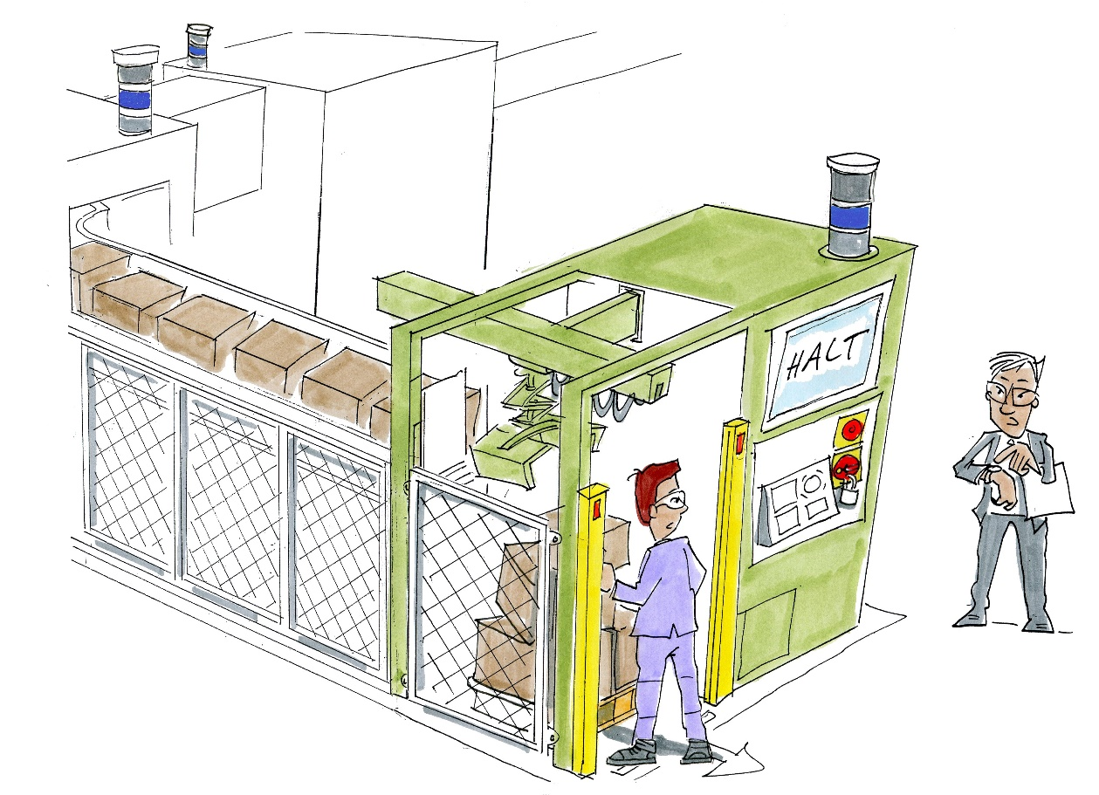
Reliable processes Example: palletizer
The palletizer must be brought to a halt in order for faults in the danger zone to be cleared
Since the palletizing process is linked to the process as a whole, this brings the entire installation to a halt
© Michael Hüter
Notes:
Problem:
In a dynamic process chain, faults in a discrete process or fluctuations in the time required for passage through an individual part of the installation may temporarily halt the entire installation. The consequence is a significant reduction in system performance.
Example: palletizing robot
A palletizing robot loads packages from a conveyor belt onto a pallet. The danger zone of the palletizing robot is safeguarded by a protective fence. The pallet discharge area is safeguarded by a light curtain. When a person enters the danger zone through the light barrier in order to clear a fault, the robot is reliably halted.
Since the palletizing station is coupled directly to the upstream parts of the installation, all linked parts of the installation must be halted in order for faults associated with the palletizing robot to be cleared.

Slide 8
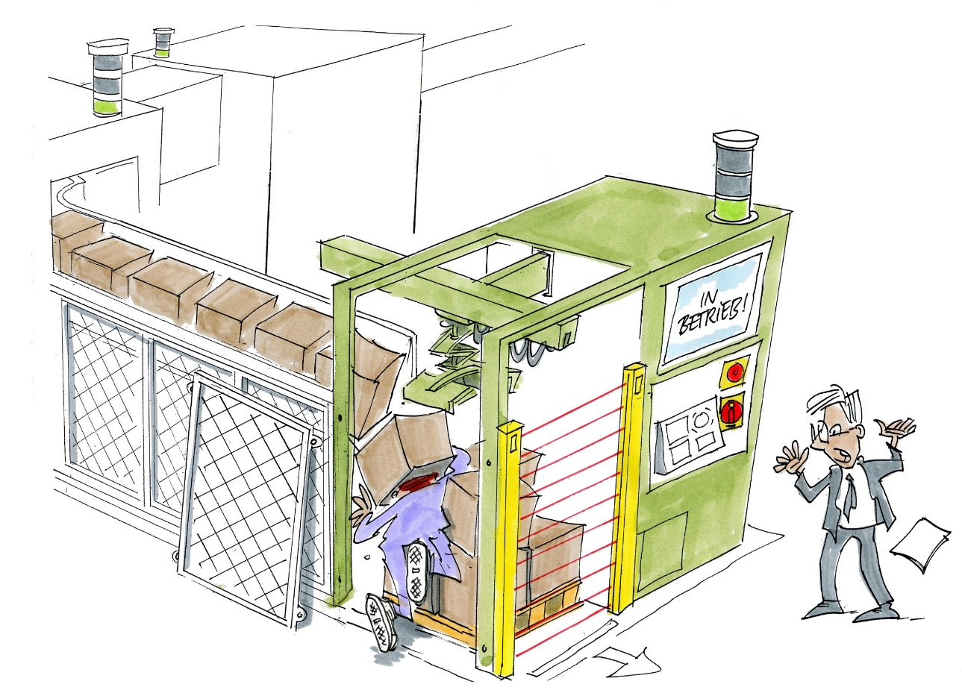
Bringing the entire installation to a halt reduces the throughput
This presents considerable incentive for the protective equipment to be defeated
The risk of accident rises dramatically as a result
© Michael Hüter
Notes:
As a consequence of all parts of the installation being halted, the throughput of the installation as a whole is substantially reduced. This constitutes a major incentive for the machine operator to bypass the light barrier so as not to have to halt the installation in order to clear a fault. The consequence is a strongly increased risk of accident.

Slide 9
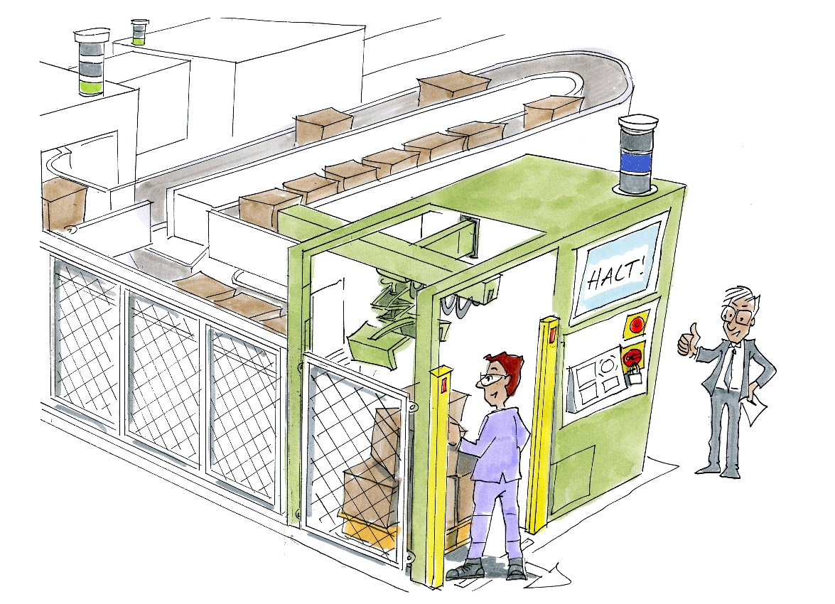
Solution: decoupling of processes in which faults occur
A buffer zone at the package infeed enables the palletizer to be decoupled temporarily from the rest of the installation
The other parts of the installation can remain in operation whilst the fault is being cleared
© Michael Hüter
Notes:
Solution:
The solution consists of temporarily decoupling the process in which a fault has occurred from the overall process. When a part of the installation is affected by a fault, decoupling enables the installation as a whole to continue in operation, or at least results in it not being brought to a halt immediately, but only after a considerable delay.
Example:
Creation of a buffer zone for the package infeed enables the palletizing process to be decoupled temporarily from the rest of the process. The remaining parts of the installation can remain in operation whilst the fault is being cleared.
Besides preventing blockages in upstream parts of the installation, the creation of a buffer zone also enables the idle time of downstream parts of the installation to be reduced. The buffer keeps a store of packages for the event that upstream parts of the installation need to be halted briefly owing to a fault.

Slide 10
Process observation with the protective equipment closed Example: packaging machine for bulk materials
Processes are difficult to adjust owing to the lack of geometry of the "workpieces"
Frequent readjustment required
If the result cannot be judged until the machine has coasted to a halt, considerable scrap has already been produced by this point
Notes:
The problem:
When machines frequently require setup procedures involving the use of expensive workpieces and tools, the operator wants to be "on the safe side". Machines often fail to offer the operator adequate means of observing the process during setup and thereby ascertaining that it will be stable and not give rise to unanticipated damage. This situation tempts users to select unsuitable operating modes and to defeat protective equipment in order to attain the desired process reliability – at the expense of their own safety.
Example: packaging machine
Owing to the "soft" materials, packaging processes in the food industry present problems, and setting them up may involve several iterative steps. It is then disadvantageous when the result of setup cannot be observed until the machine has coasted down. In order to keep waste to a minimum, protective equipment that prevents the process from being observed when closed is frequently defeated.

Slide 11
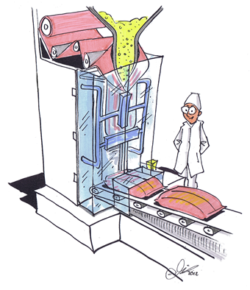
Solution: transparent guards
When transparent materials are selected for protective equipment, the process can be observed directly.
If necessary, mirrors or cameras can also be used.
© Michael Hüter
Notes:
Measure:
The operator is provided with the facility to observe the process directly whilst setting it up.
Example:
Transparent guards are frequently used on food processing and packaging machines in order to permit observation of the process. Visibility of the process can be enhanced further still by means of mirrors or cameras inside the machine.

Slide 12
Straightforward fault rectification Example: Tubular bag packaging machine
© Michael Hüter
Following a change of film, the first bag must be supported manually before the process can continue automatically
Position switches that are permanently defeated present considerable danger, for example during rectification of a fault on a machine that has not been safely halted
Notes:
The problem:
Some processes are very difficult to set up when exactly the right values are required for the temperature, pressure, speed, etc. When the process flow is interrupted, it may take the parameters a long time to reach the setpoint values again. In order to keep these down times and the wastage from the machine to a minimum, protective equipment that halts the processes when opened is defeated.
Example: packaging machine in the food industry
Tubular bag packaging machines (the slide shows such a machine with a vertical arrangement) particularly often require formation of the first bag to be supported manually after a change in film. This entails drawing the film on manually until the process runs automatically. If the machine does not offer a suitable operating mode for this task (safe inching mode with the protective equipment open), the position switches safeguarding the safety guards on the front of the machine are defeated, or the discharge tunnel is shortened or removed. This phenomenon, which is often observed during plant inspections, leads time and again to severe accidents (burns to and amputations of fingers), since defeating of the safety guards enables operators to reach into the machine, which has not been safely halted, for example in order to rectify faults (such as film sticking to the sealing jaws).

Slide 13
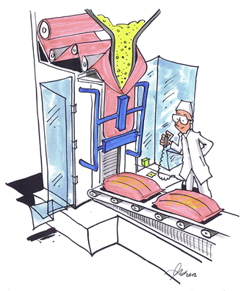
Solution: fault rectification in inching mode
The protective equipment can be opened in inching mode
Hazardous zones are safeguarded individually
The speed or force can be reduced and safely limited if necessary
© Michael Hüter
Notes:
Measure:
If interventions in the machine are nevertheless needed whilst the protective equipment is open, for example for setup work or fault rectification, alternative measures must be taken. These measures generally involve safe inching operation, where permitted by the process, with a safely limited speed or force.
Example: packaging machine
The guards at the zones at which manual intervention occurs can often be designed such as to provide access. The hazardous zones that are reachable must then be safeguarded individually. The remaining hazardous zones must remain beyond reach.
An operating mode that enables the machine to be operated with the protective equipment open but without substitute measures, such as safe inching mode, is neither necessary nor permissible in the food industry.

Slide 14
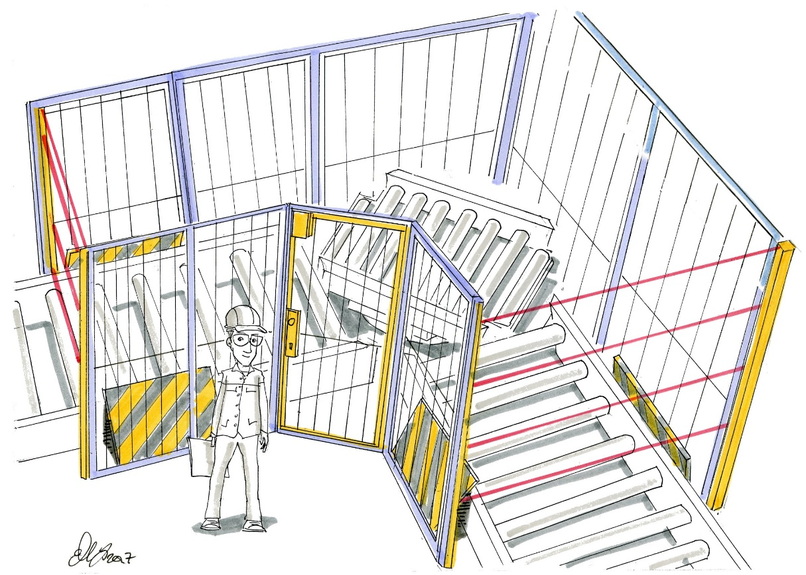
Straightforward fault rectification Example: rotary table
Hazards presented by crush, shear and entrapment points on the linked conveyors
Guards are an obstruction during:
Clearance of faults
Cleaning work
© Michael Hüter
Notes:
Problem:
Fixed and movable guards may be an obstruction to fault rectification and cleaning work.
Example: corner turntable
On corner turntables employed for a change in direction on roller conveyors, rotation of the turntable gives rise to crush, shear and entrapment points between the turntable and the adjoining conveyors. Where guards are used to safeguard the resulting hazardous zone, they obstruct the necessary maintenance work on the moving machine parts (such as fault rectification, cleaning work). An incentive arises for the operating personnel to defeat the protective equipment.

Slide 15
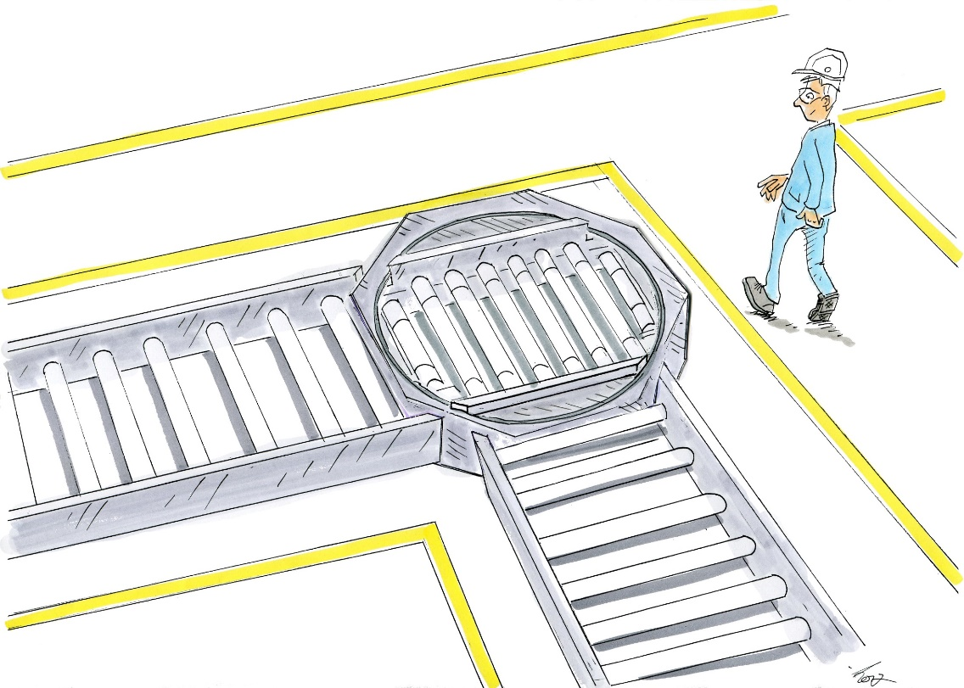
Solution: version with stationary frame
Avoidance of crush, shear and entrapment points by fitting of a stationary frame
With the hazard points eliminated, guards are no longer required, and unimpeded access is therefore provided for the clearance of faults and for cleaning
© Michael Hüter
Notes:
Solution:
One solution in this case is the fitting of a stationary frame within which the turntable can rotate. Crush, shear or entrapment hazards are eliminated as a result. The inherently safe design renders protective equipment superfluous and permits unobstructed access for the purposes of fault rectification and cleaning.

Slide 16
Safe drive control Example: machine tool
Measurement must be performed on the workpiece, consequently:
Machining must be interrupted, however:
Without de-energizing the tool spindle (position control)
Unexpected start-up of the spindle presents a hazard!
Notes:
The problem:
Work must be performed in the hazardous zone during operation of a machine. This concerns tasks such as setup, adjustment, measurement and fault rectification. The protective equipment is disabled in order to enable persons to be present in the hazardous zone whilst the machine is in automatic mode.
Example: setup mode on a machine tool
During setup of a machine tool, the operator must halt the machining process and enter the workspace in order to perform measurements on the workpiece. Unexpected startup of a motor presents a risk of injury. On this machine, it is not possible to de-energize the tool spindle, since this would result in an unacceptable loss of position. The drive control must therefore maintain the position of the spindle.

Slide 17
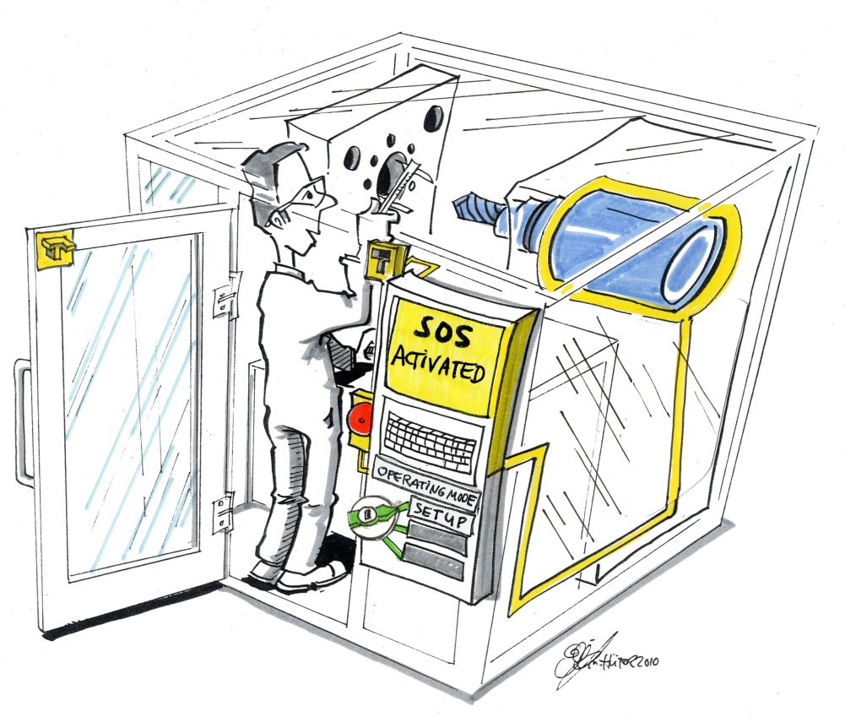
Solution: setup mode on machine tools
Setup mode is activated
The safety guard is no longer monitored, but the drive control has safety functions
Safe operating stop
or
Safe torque off
© Michael Hüter
Notes:
Measure:
Special operating modes are provided for situations in which persons are present in the hazardous zone. This enables adequate safety to be attained by measures including:
• Use of a manual control unit
• Movements only at limited speed
• Movements only in inching/enabling mode
• Movement of discrete axes only
Drive control devices with integral safety functions, such as safely limited speed (SLS) and safe operating stop (SOS), are useful for this purpose. All tasks that must be performed are possible, and an incentive for the defeating of protective equipment is avoided.
Example:
In order to prevent unexpected starting of spindle movement, a drive control employing the safe operating stop (SOS) safety function is used. All other drives are also at rest, by means either of a further SOS safety function or a safe torque off (STO) function. The safety functions generally satisfy Performance Level d to EN 13849-1. Before the safety guard is opened, the safety functions are activated by switching of the operating mode selector switch to the setup position; this also deactivates monitoring of the safety guard position. The measures described here prevent unanticipated start-up with adequate safety. Users are not obstructed in their work, and no incentive exists for the defeating of protective equipment.

Slide 18
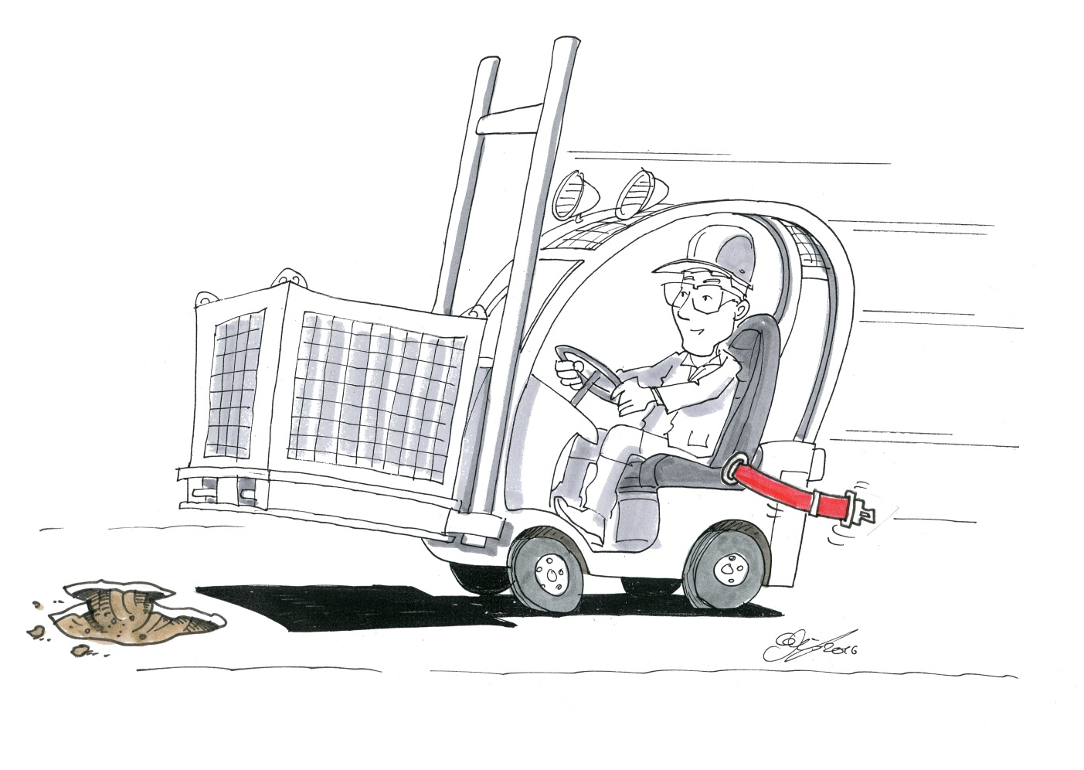
Easy handling of protective equipment Example: fork-lift trucks
Seat belts on fork-lift trucks for driver restraint are unpopular among drivers
© Michael Hüter
Notes:
Problem:
When protective equipment must be handled manually by users because it must be fitted, exchanged or placed in the safe position before a machine or installation is used, its acceptance by users depends very much upon the convenience of its use. This acceptance drops with a rising number operations and the time they entail.
Example: fork-lift truck
The fitting of driver restraint systems to fork-lift trucks has been mandatory for some time. Seat belts, being the cheapest solution, are also that most often used. Acceptance among drivers is however low, particularly when they must enter and leave the truck frequently.

Slide 19
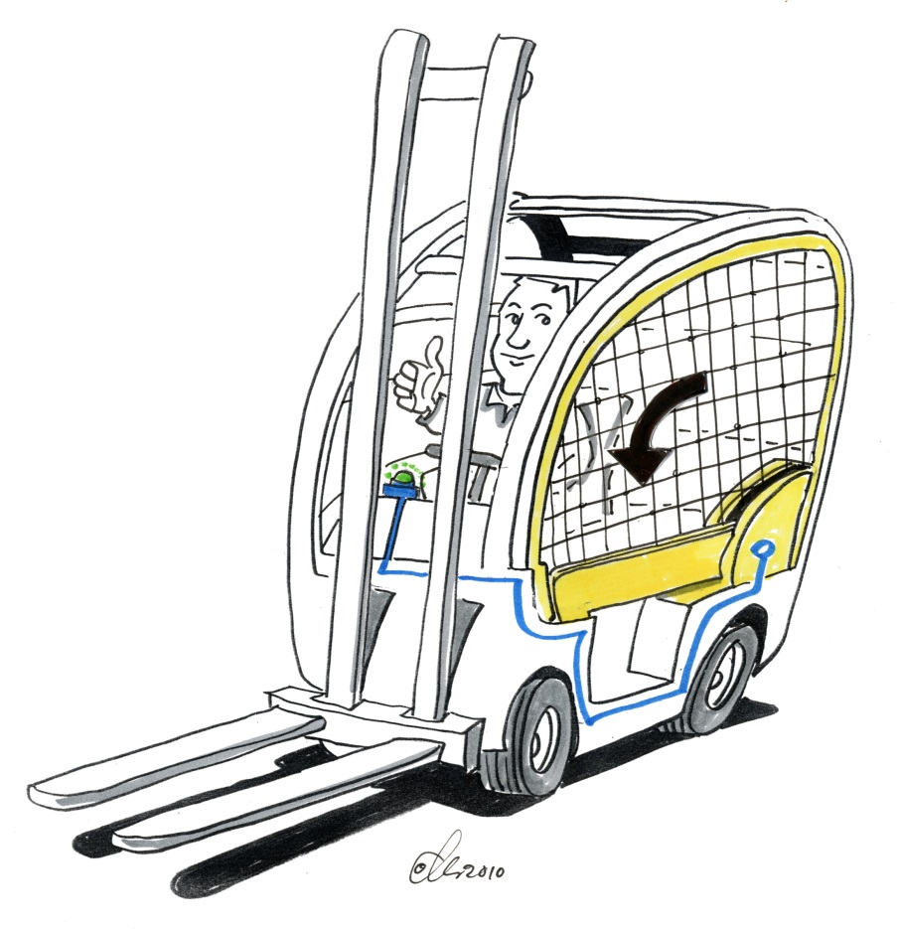
Solution: automatic driver restraint system
Automatically closing driver restraint system
Does not obstruct the driver
closes depending on speed (possibly)
© Michael Hüter
Notes:
Measure:
Protective equipment must be easy to operate. Automatic or at least semi-automatic closing of protective equipment eliminates an incentive for it to be defeated, and should be given preference over manual operation. Mounting elements for guards, such as screws, that are required to keep the guard securely in position must permit quick and reliable release and refitting (no fine threads; no longer than necessary; if possible, latch closure should be used). Interlocks of movable guards with electromechanical guard locking should be given preference over manually operated interlocks, since the latter require the user to wait until the end of the guard locking time even when the machine was not previously running.
Example:
One manufacturer of industrial trucks has developed a restraint system for the drivers of fork-lift trucks with the name "netProtect" (www.still.de/9231.0.43.html). This system prevents the driver from being trapped between the protective canopy and the ground should the truck overturn. When the driver has accessed the fork-lift truck, touching a sensor causes the restraint system to move into the protection position. This safety device has a number of benefits. Onerous fastening and release of the seatbelt is no longer necessary when the driver enters and leaves the fork-lift truck. Despite the device, the driver enjoys maximum freedom of movement. Operation by means of the sensor is also very simple. If the net is not closed, the driver first receives a visual warning when he or she drives off. If the retaining bar is not closed and the protective net is not under tension, the speed of the fork-lift truck is limited to 5 km/h; at this speed, tipping of the fork-lift truck need not be anticipated. Alternatively, the protective equipment can be closed automatically when a certain speed is reached (up to a maximum of 5 km/h). These benefits result in greater acceptance among drivers.

Slide 20
Protective equipment does not obstruct the production flow Example: roller intake point
Intake points on counter-rotating rollers
Guards are an obstruction when:
The process must be observed when the installation is started up
Faults must be rectified swiftly
Minor cleaning work is performed
Notes:
The problem:
Counter-rotating rollers present a risk of parts of the body being trapped. The entrapment point must therefore be safeguarded in a suitable way. Some standards make provision for fixed guards for this purpose. This however is frequently in conflict with the production/process needs of users. Startup of the installation is made considerably more difficult by these guards. It must also be possible for caking of product on the rollers to be removed manually whilst the machine is running.

Slide 21
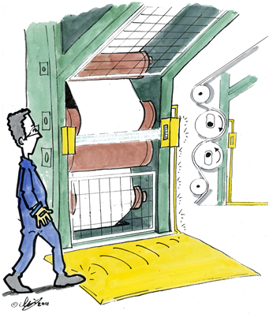
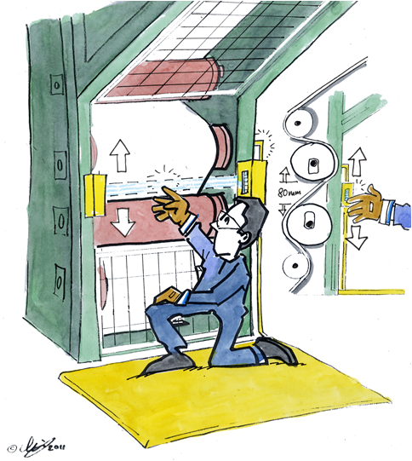
Solution A: Safeguarding by means of activatable light barriers
© Michael Hüter
© Michael Hüter
Light barrier is activated
Rollers move apart
Notes:
Measure:
Automatic activation of protective equipment when persons approach the hazardous zone provides effective safeguarding whilst at the same time not obstructing operation of the machine. An incentive for defeating of the protective equipment does not therefore exist. A proven solution for automatic mode is the combination of a pressure-sensitive mat and a light barrier or flap in front of the intake point. Other operating modes, such as setup and startup, require other protective measures (such as inching mode, enabling mode, movements only with the rollers moved apart).
Example A:
Safeguarding by means of light barriers
In this safety concept, a light barrier is located in front of and as close as possible to the intake gap. The light barrier may be:
- Activated permanently
- Activated by a switching plate (Figure 1)
The latter of these options is preferable, since it largely prevents the safety function being tripped by the material being processed. The light barrier must trigger rapid separation of the rollers (see Figure 2).
Owing to the high production speeds, rapid braking of the rollers is not possible. In order to prevent nuisance tripping of the safety function by inadvertent reaching through the light barrier, a visible marking in the proximity of the light barrier should draw attention to the safeguarded zone (for example by marking on the perimeter of the rollers with the aid of laser beams).
The use of light barriers is not recommended when materials being processed emit substantial vapour, since this can also cause nuisance tripping. In these cases, preference should be given to option "B" with the movable flap.

Slide 22
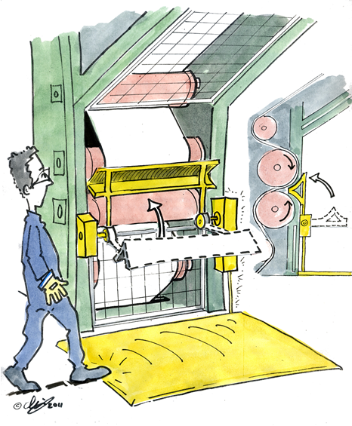
Solution B: Safeguarding by means of a swing guard
When the pressure-sensitive mat or plate is stepped upon, the protective flap swings in front of the intake gap
Important:
Hazards are to be avoided by this measure.
© Michael Hüter
Notes:
Example B: Safeguarding by means of a switching plate and flap with power drive
At the heart of this protection concept is a movable flap that, when swung aside, does not obstruct the manufacturing process (thereby avoiding the buildup of heat, for example) and that permits a good view of the work process. The flap (guard) automatically swings against the intake gap (see Figure 3) when the switching plate is stepped upon.
The rollers can then be cleaned safely. Wide calenders can impair the mechanical strength of the flap. The flap must be prevented from presenting a hazard when swinging, for example by measures for force limitation.

Slide 23
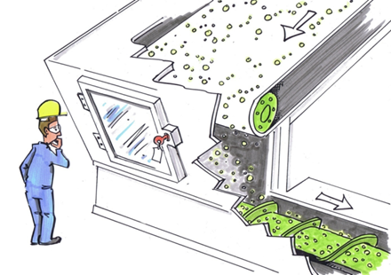
Permitting continual visual monitoring Example: Conveyor screw for bulk materials
A viewing window is fitted, but considerable dust is generated, and the inside of the window must therefore be cleaned frequently
© Michael Hüter
Notes:
The problem:
Some processes require continual visual monitoring by the operating personnel. Where a maintenance access point is provided on the machine, it can be engineered as a transparent movable guard that can be used not only for maintenance, but also for viewing of the running process. Where the process involves the generation of high quantities of dust, however, assurance of an unimpaired view may require the maintenance access point to be opened substantially more frequently for cleaning purposes than would be necessary for maintenance of the machine. Depending upon the maintenance interval, scale of dust generation and form of the protective equipment, this in turn gives rise to a number of incentives for tampering:
- If a tool or key are sufficient for opening the protective equipment, it must be assumed that under the circumstances described above, a possibility is created for the running process to be viewed unimpeded without loss of time. A key for example would typically simply be left in its lock.
Equally, if the protective equipment features an interlock that causes the machine to be halted automatically when it is opened, it can be assumed that the protective equipment will be defeated – for example by bridging of the guard switch – in a way that permits continued operation even when the protective equipment is open.
Example:
To permit visual inspection without the protective equipment having to be opened, the maintenance access point on a screw conveyor is engineered in the form of a transparent movable guard. The product standard states that where access for maintenance or repair purposes is necessary only at intervals of over eight hours, an access arrangement employing only a key or tool is adequate; electrical interlocking of the protective equipment is not required in this case.
Where access for maintenance or repair purposes is necessary at shorter intervals, the standard additionally requires an electrical interlock to be fitted that halts the hazardous movements sufficiently quickly when the guard is opened. The access point need not be locked or screwed shut. Since with this solution, too, visual observation of the running process is more difficult when the viewing window is soiled, it can be assumed that the protective equipment will be defeated in order for the running process not to have to be continually interrupted.

Slide 24
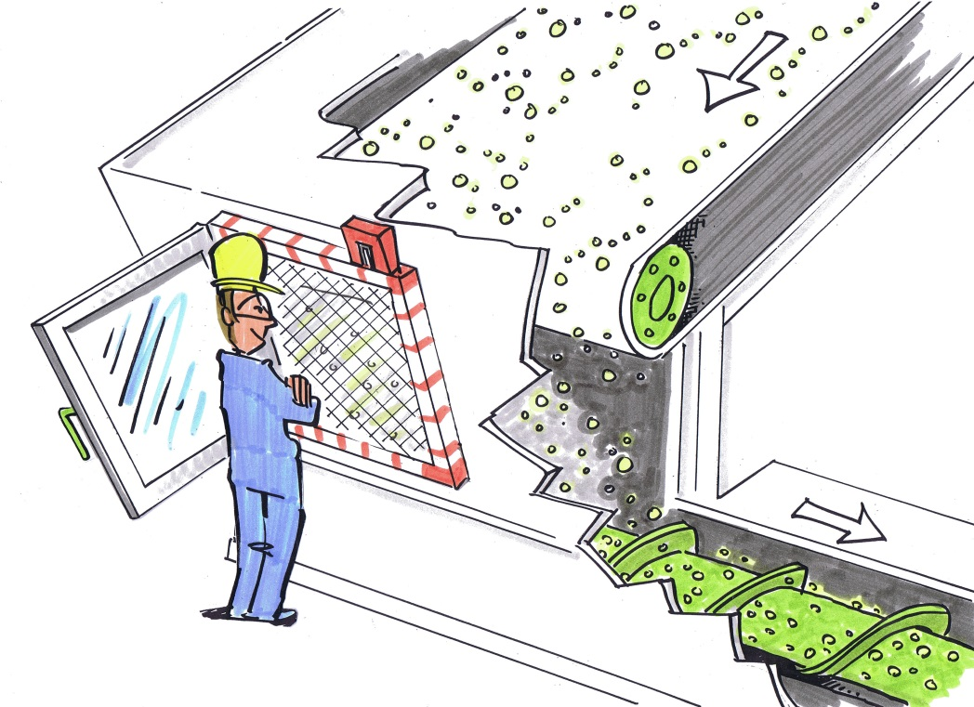
Solution: provision of a second item of protective equipment in addition to the viewing window
The viewing window can be opened at any time for the purpose of cleaning
If intervention in the process is required, it is possible without danger by opening of the mesh
Additionally, the mesh is interlocked with the drives
Observing the process, maintenance and repair are not obstructed in any way
© Michael Hüter
Notes:
Measure:
In order to eliminate the incentive for defeating of the protective equipment, a solution must be found that enables the process to continue uninterrupted and at the same time to be viewed without obstruction, without the protective action of the protective equipment being circumvented. One design solution is the use of a second item of protective equipment that continues to provide adequate safeguarding of the hazardous zone when the first item of protective equipment is open.
Example:
The following solution presents a much lower incentive for defeating of the protective equipment. In this solution, a mesh with an electrical interlock is located behind the access opening (which may or may not contain a window). The working area can be viewed through this mesh whilst the machine is running. Should access be required, opening the mesh causes the hazardous movements to be brought to a halt. This arrangement has disadvantages neither for the workflow, nor for maintenance or repair.

Slide 25
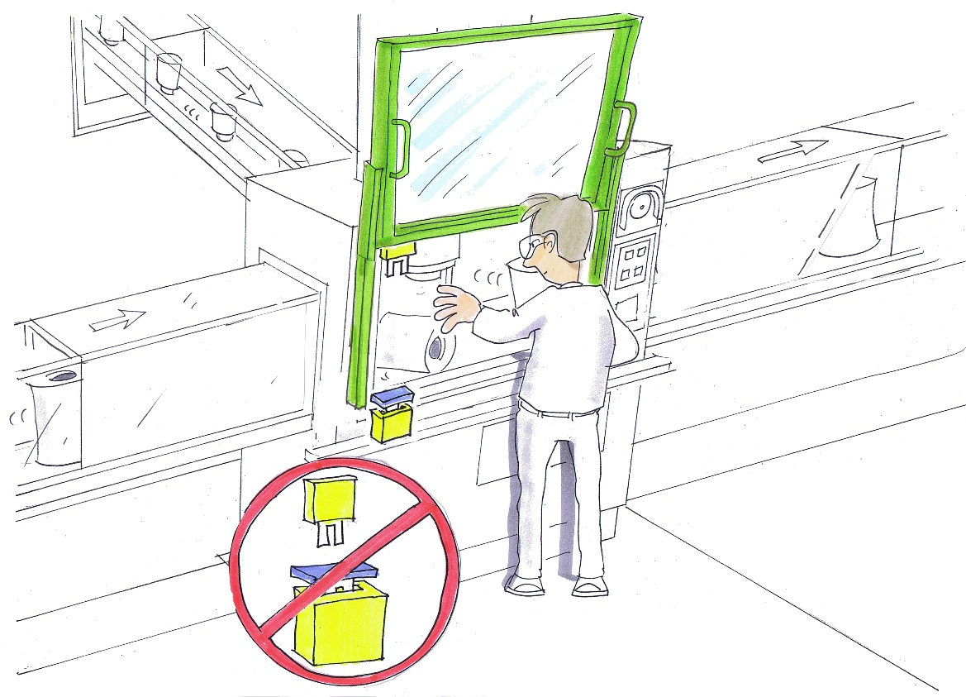
Preventing the defeating of protective equipment Example: interlocking guards
Frequent operation of the interlocking guard slows down the work process
An incentive is created for defeating
© Michael Hüter
Notes:
Problem:
Some automatic processes require regular intervention by the machine operator. If the risk of injury requires the process to be interrupted for the duration of the intervention, interlocking guards are generally employed.
The more frequently intervention in the process is needed, the greater the disturbance of the work process caused by operation of the guard. The operator will wish to reduce the duration for which the machine is at a standstill and will consequently attempt to avoid regular – and therefore unergonomic – operation of the protective equipment. In the long term, this will lead to the guard being defeated, and in turn to the operator not being protected against the machine's movements when he or she intervenes in the work area.

Slide 26
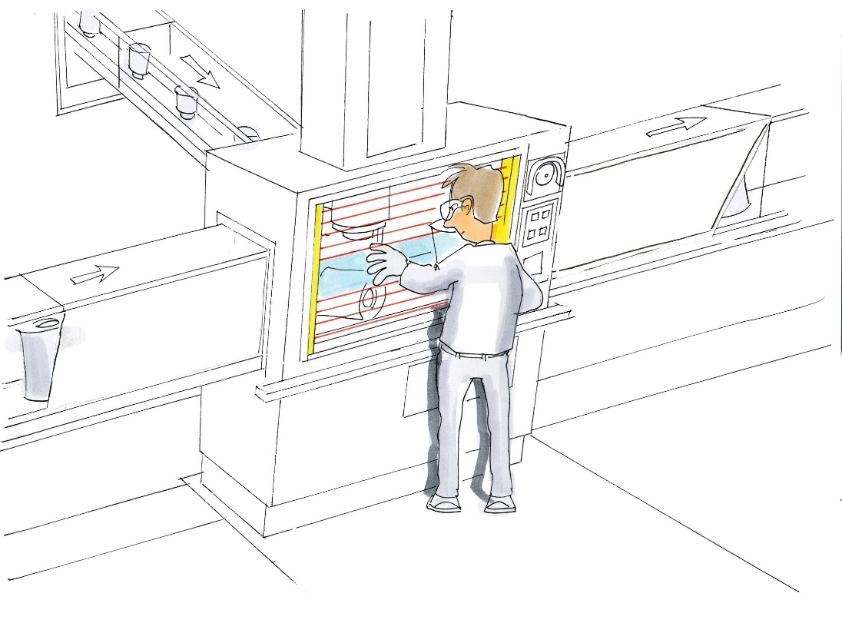
Solution: electro-sensitive protective equipment
Safeguarding of the hazardous zone by means of a light curtain:
An intervention causes the process to be halted; when the light curtain is no longer interrupted, the process restarts automatically
Down times are reduced
Important: Run-on times must be considered
© Michael Hüter
Notes:
The measure:
If the work process does not cause emissions, electro-sensitive protective equipment is often the best choice. When the danger zone is safeguarded by a light curtain, any intervention in it by the operator causes the drives to be halted automatically. The machine can also be restarted automatically as soon as the operator no longer interrupts the light beams. Operation of the protective equipment in this way is intuitive. The working area can be accessed directly without the protective equipment first having to be moved. As a result, the time during which the machine is at a standstill is reduced to a minimum, leading in turn to an increase in the machine's throughput. The incentive to defeat the protective equipment is eliminated.
Run-on times of the moving parts of machinery must however be considered. If these are too long, electro-sensitive protective equipment may not be suitable.

Slide 27
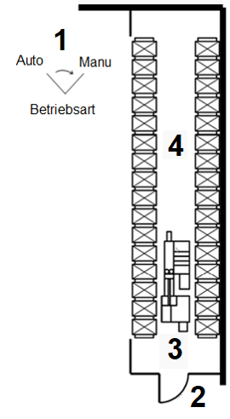
Access control Example: high-rack warehouse
Inhomogeneous stored goods cannot be prevented from causing faults in high-rack warehouses.
Faults can sometimes be rectified only by local manual operation of the storage and retrieval machine.
Visibility in high-rack warehouses is poor.
Operating Mode
Operating mode selector switch with key
Access door with second key
Storage and retrieval machine
Rack area
Notes:
The problem:
No clear procedures exist that must be followed in the event of outages on a complex installation or machine:
- Opening or removal of interlocked protective equipment interrupts the program flow in such a way that when the safe state is restored, the program is not resumed from the point at which it was interrupted.
- Fault rectification is difficult and time-consuming for the user, owing to the need to move long distances, or owing to complicated opening mechanisms.
Protective equipment is defeated so as to make fault rectification as easy as possible for the user, not only out of convenience, but also in order to optimize the processes.
Example: automatic high-rack warehouse
Faults may arise in rack areas as a result of displaced or faulty storage vessels. The rack area is safeguarded against unauthorized access by means of fencing and may be accessed only when the automated mode has been safely de-energized (manual mode). The access door is interlocked mechanically.

Slide 28
Solution: Inseparable connection of the protective equipment
Inseparable connection of the key for the operating mode selector switch, with is also used for operation of the storage and retrieval machine, to the key for the access door
Notes:
Measure:
Faults cannot be avoided entirely in certain production processes. The user is given means of rectifying the fault that are sufficiently straightforward for no benefit to be gained from defeating protective equipment. The concepts for the rectification of faults are set out in procedures.
Example:
One key for operation of the relevant storage and retrieval machine within the hazardous zone and one key for the relevant access door are joined to each other inseparably by means of a welded ring. This guarantees that a certain procedure is followed during fault rectification. In automatic mode, the key must be inserted into the control console. It cannot be withdrawn from the control console when the "Automatic" operating mode is selected; the "Manual" operating mode must therefore be selected before the access door can be opened.
This system prevents the storage and retrieval machine from being operated if the following procedure is not observed:
1. Outside the hazardous zone, set the operating mode selector switch on the control console from "Automatic" to "Manual" and withdraw the key
2. Access the hazardous zone by means of the key through the door monitored by means of a position switch; close the door, in order to prevent further persons from accessing the hazardous zone
3. Activate the storage and retrieval machine by means of the key
4. Perform the hazardous movements of the storage and retrieval machine in manual mode
The procedure is followed in reverse order for departure from the storage area and re-activation of automatic mode.

Slide 29
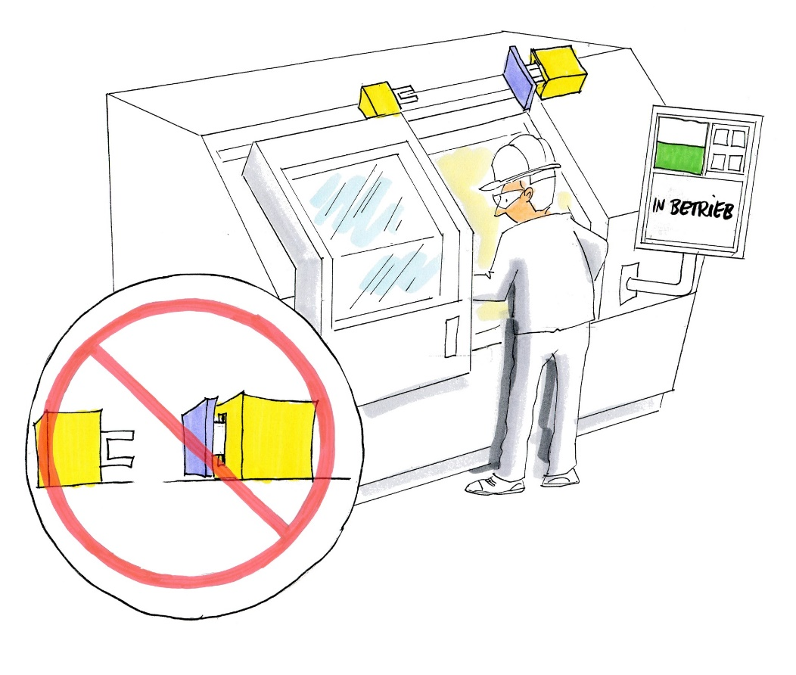
Obstructing defeating Example: interlocking devices with low coding level
Unless additional measures are taken, interlocking devices employing actuators with low coding level can generally be defeated easily
© Michael Hüter
Notes:
Problem:
Protective equipment that is easily defeated
Example:
Unless additional measures are taken, interlocking devices employing actuators with low coding level can generally be defeated:
Within a short space of time
Without special knowledge
With readily available objects (for example with an additional, prohibited actuator)
This applies to all interlocking devices with an external actuator (Type 2 and Type 4). The manipulation can also be reversed quickly. For this reason, the defeating of interlocking devices with low coding level accounts for the majority of manipulations on protective equipment.

Slide 30
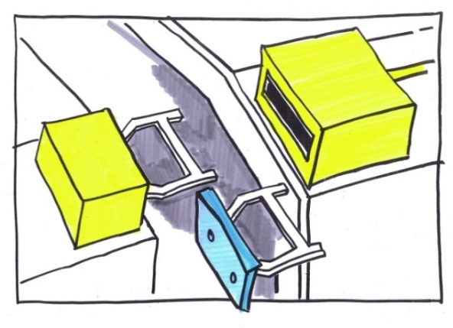
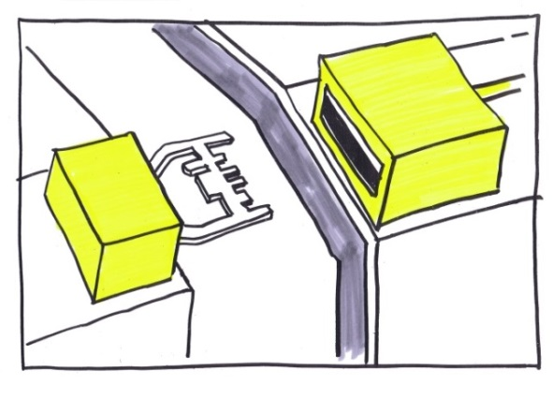
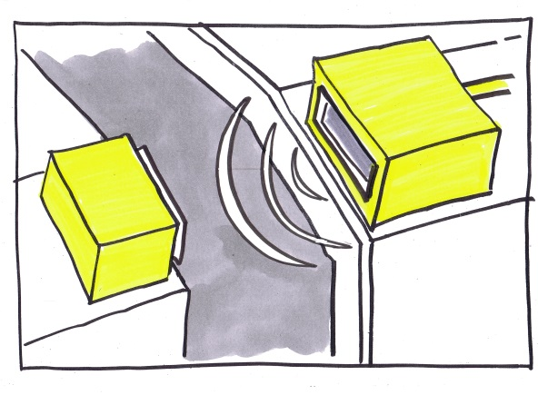
Solution A: interlocking device with high coding level
✗
(1)
✓
(2)
✓
© Michael Hüter
© Michael Hüter
© Michael Hüter
Use of Type 2 (1) or Type 4 (2) interlocking devices with high coding level
Notes:
The measure:
A: Use of an interlocking device with a higher coding level (Type 2 or Type 4)
Type 4 switches are interlocking devices employing electro-sensitive position switches. In contrast to the magnetic-operated coding of coded Type 4 switches with low coding level, the coding of coded Type 4 switches with high coding level is achieved by means of an RFID transponder.
An advantage of Type 4 switches over Type 1 and 2 interlocking devices is their encapsulation. This makes them immune to emissions caused by the process or from the environment, which in turn makes them ideal for use in industrial environments associated with high emissions.
In order to limit the scale of maintenance and to assure availability of the machines, modern Type 4 switches enable the replacement for a defective actuator to be "taught"' on the switch. The switch "remembers" the previous actuator and no longer allows it to be used. This enables the defective actuator to be repaired without creating a new opportunity for defeating. Defeating of the protective equipment is made virtually impossible.

Slide 31
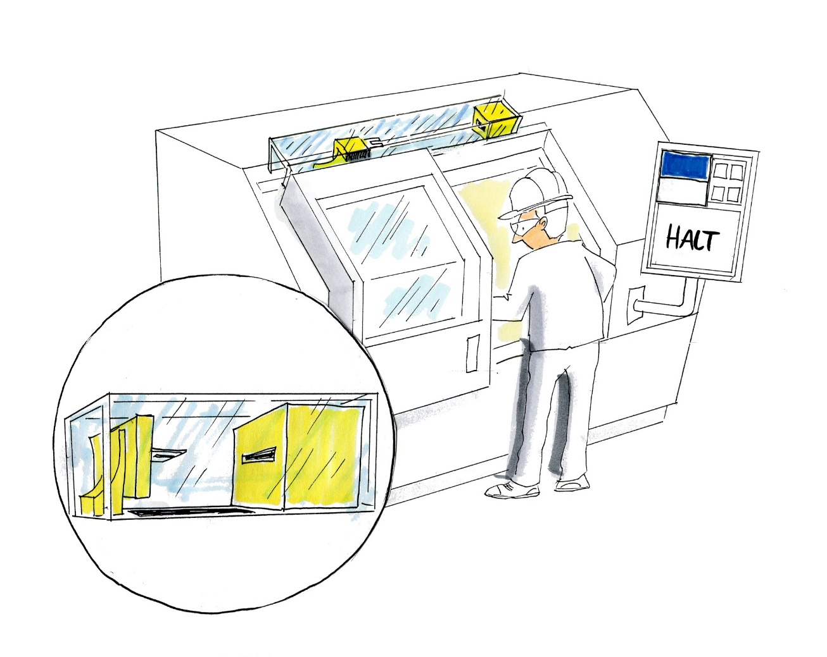
Solution B: fitting of an interlocking device in a shrouded position
The use of substitute actuating elements to defeat the protective equipment is impeded by the interlocking device being fitted in a shrouded position
© Michael Hüter
Notes:
The measure:
B: Fitting of an interlocking device in a shrouded position
If the switch is fitted at a shrouded location, it is either difficult to reach or completely inaccessible for substitute actuation elements. Defeating of the switch is made considerably more difficult.

Slide 32
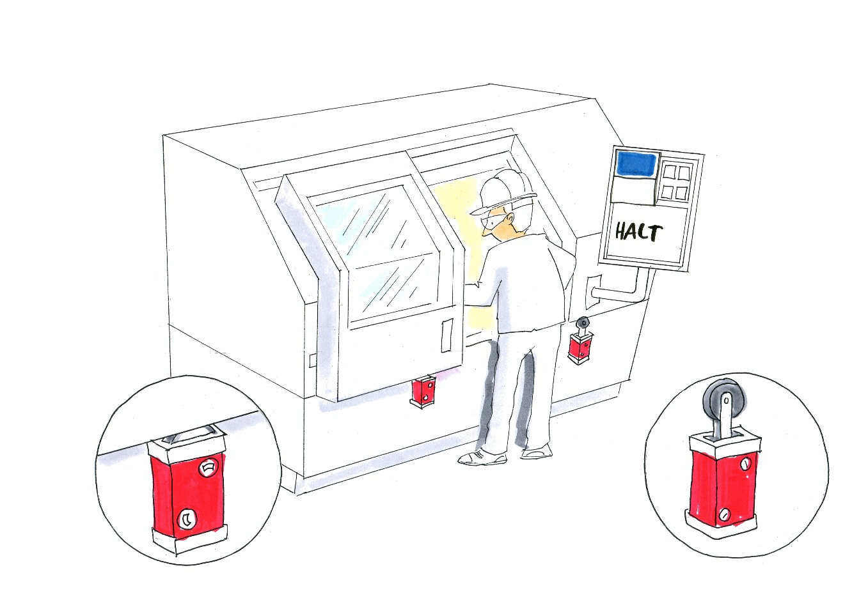
Solution C: make/break contact combination
Combination of two Type 1 switches, one used as a break contact, the other as a make contact
Monitoring for plausibility in the machine control: defeating is reliably detected
Important: use inseparable mountings
© Michael Hüter
Notes:
The measure:
C: Make/break contact combination
A make/break contact combination comprises two Type 1 switches, one employed as a break contact (contact opens when the switch is actuated), the other as a make contact (contact closes when the switch is actuated). The positions signalled by the switches must be interpreted in the machine control system and tested for plausibility. As a result, defeating of one of the switches or removal of the protective equipment to be monitored is detected.
A condition is that an inseparable form of mounting was used for fitting of the switches, since they could otherwise be removed and the protective equipment defeated.

Slide 33
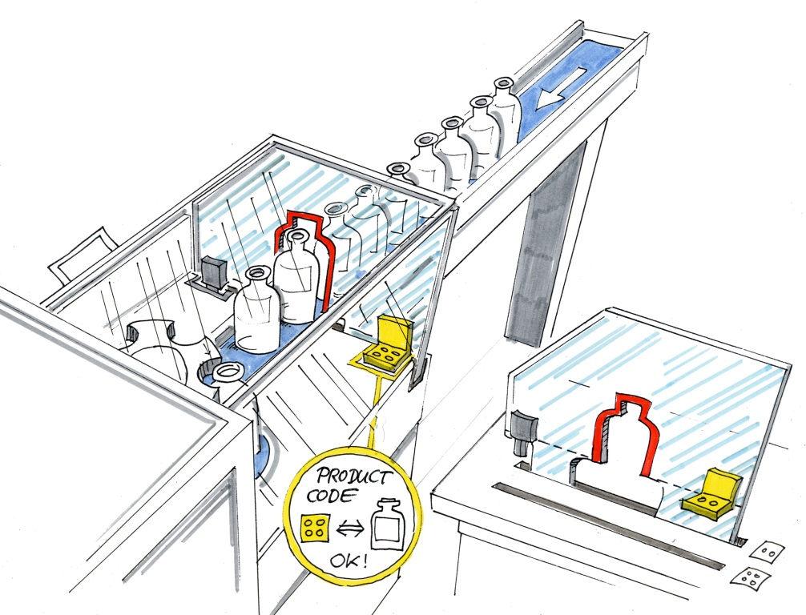
Coded protective equipment Example: bottle cartoning machine
Different protective equipment
Adapted to the size of the workpieces
All bottles fit through the largest aperture – but so do the operator's hand and arm.
© Michael Hüter
Notes:
The problem:
When protective equipment must be substituted regularly on machines or installations, for example in order to adjust the process to different workpieces or requirements, users may be tempted to fit protective equipment that enables most or all the processes occurring to be performed. The result may be that the hazardous zones are not adequately safeguarded.
Example: bottle cartoning machine
Bottles of different sizes are packed on a bottle cartoning station. Owing to their geometry, the bottles may occasionally tip over. Access to the hazardous zone is prevented by a hood, the position of which is monitored, and by an interchangeable cover (see figure). If the cover is not fitted, its absence is detected by means of a position switch, and the machine is prevented from starting up by safety-oriented technology. The interchangeable cover contains an aperture adapted to the size of the bottles. When an incorrect cover with too large an aperture is used, the workers are able to reach past the other bottles to the tipped-over bottles. The operator is thus able to reach the hazardous zone without having to open the hood and stopping the production process.

Slide 34
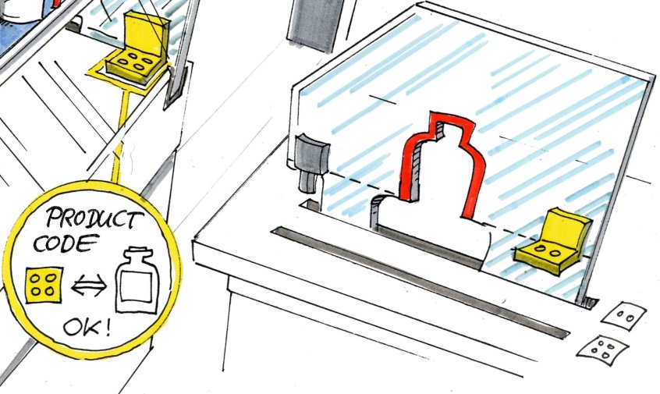
Solution: monitoring by means of a product code
The controller (PLC) detects whether the code on the protective equipment fitted matches the workpiece currently being processed.
© Michael Hüter
Notes:
Measure:
The process controller receives instantaneous information on the protective equipment fitted. The production program compares the detected protective equipment with that expected. An inconsistency signals that the presence of an incorrect item of protective equipment has been detected, and the production process is prevented from continuing. Codes are applied to the protective equipment to enable them to be identified. The codes can also be retrofitted on machines that have already been supplied. The control technology used for this purpose does not need to be safety-oriented.
Example:
It is ensured that the correct cover is in use. For this purpose, coded brackets with different holes are fitted to the different covers. The PLC reads the coding with the aid of proximity switches. The size of bottle currently being processed, and thus also the required cover, are known to the PLC program. Should the wrong cover be used, the machine is prevented from starting up.

Slide 35
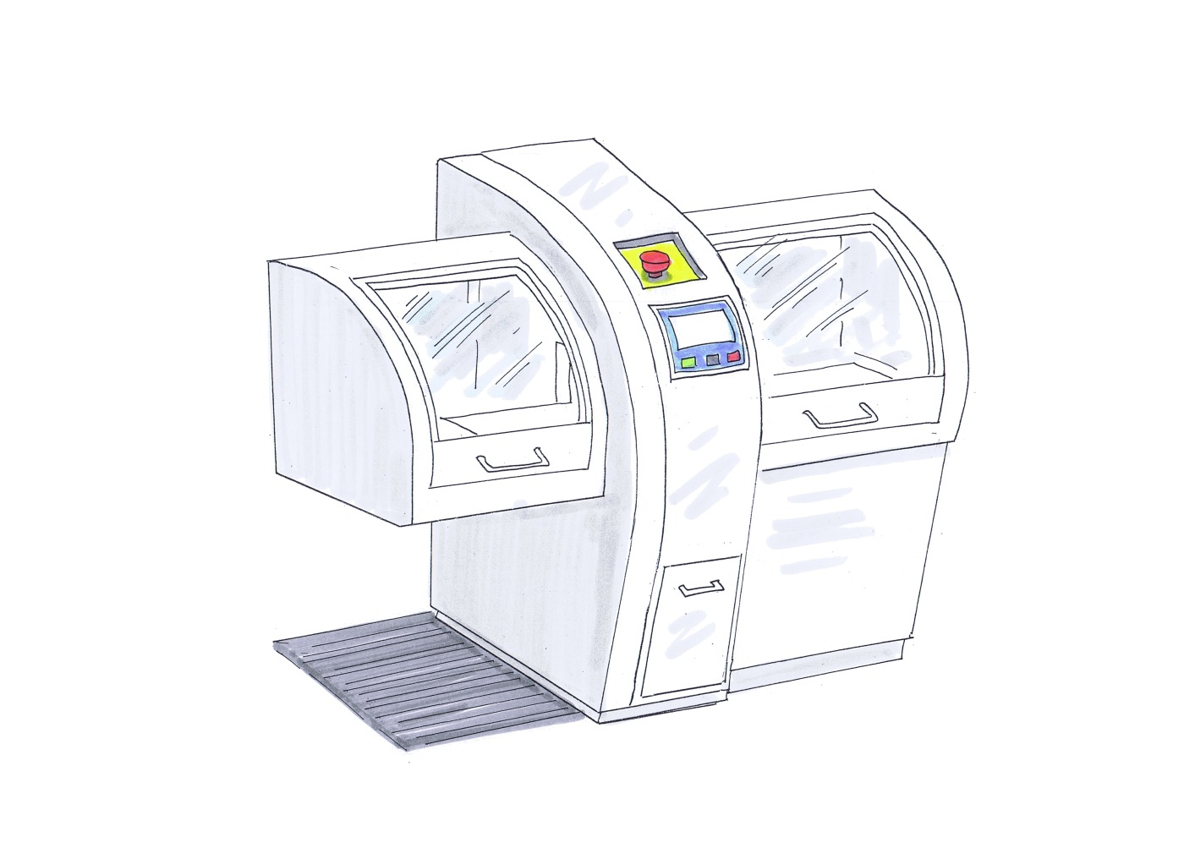
Detecting defeating Example: bread slicer
The lid must be opened for retrieval of the loaf after each slicing operation
The lid is interlocked electrically with the blade drive
If the interlock is defeated, the lid can be left open
© Michael Hüter
Notes:
The problem:
Some processes require frequent manual intervention by the operating personnel. Where the risk of injury is such that the process must be interrupted for the duration of the intervention, interlocking guards are often used that bring the hazardous movement to a halt when actuated. For the user however, frequent actuation of the protective equipment is time-consuming. Such items of protective equipment are therefore frequently defeated in order to facilitate and speed up the work.
Example: bread slicer
The operator of a bread slicer must open the flap before retrieving a sliced loaf and close it again afterwards before the next loaf can be sliced. In order to avoid the flap having to be closed after each cycle, the associated switch on the protective equipment was defeated.

Slide 36
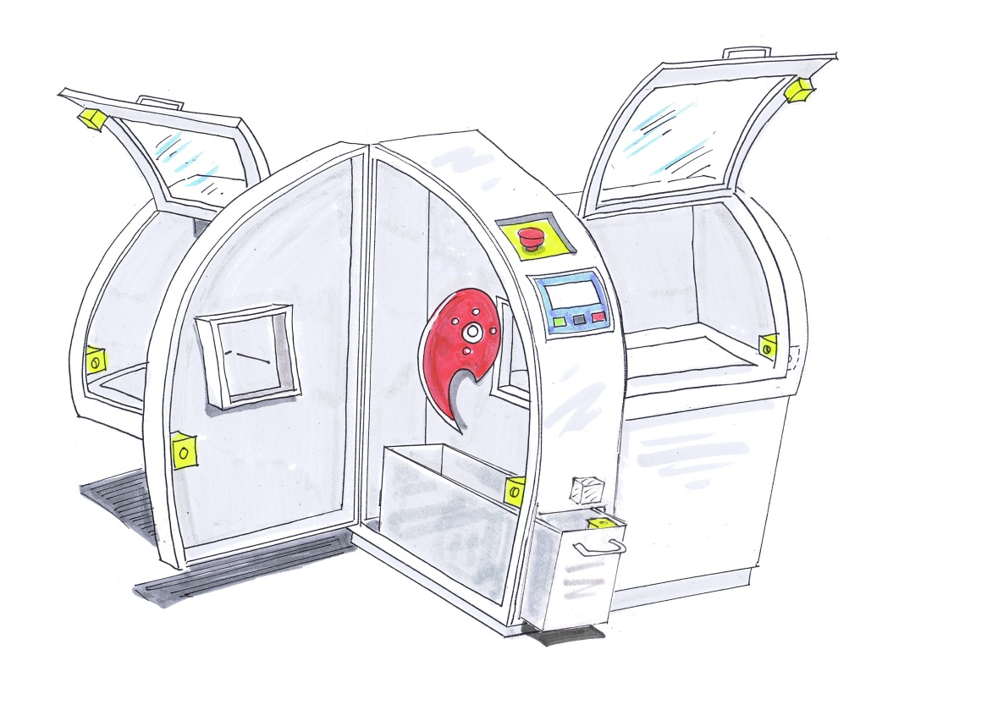
Solution: monitoring of the change of state
The lid must be opened at least once after each slicing operation
When the interlock is intact, this brings about a change in state
Interruption of the logical sequence can be detected easily by a suitably programmed controller
The controller is able to prevent the machine from running until the manipulation has been reverted
© Michael Hüter
Notes:
Measure:
On machines equipped with control logic (PLC), it is possible with little effort to monitor the change in state of interlocks brought about by the process and to block operation of the machine should they be defeated. This arrangement can of course also be defeated, but only with considerably greater effort.
Example:
On the bread slicer, the flap over the retrieval point (left-hand image, left-hand side) is interlocked with the drive such that opening the flap brings the drive to a halt. This measure prevents access being gained to the zone in which the blade moves. The controller was optimized so as to detect defeating: it checks whether the flap over the retrieval point has been opened (at least once) after a predefined number of cycles. If it has not, the controller determines that defeating has occurred, and the machine switches itself off.

Slide 37
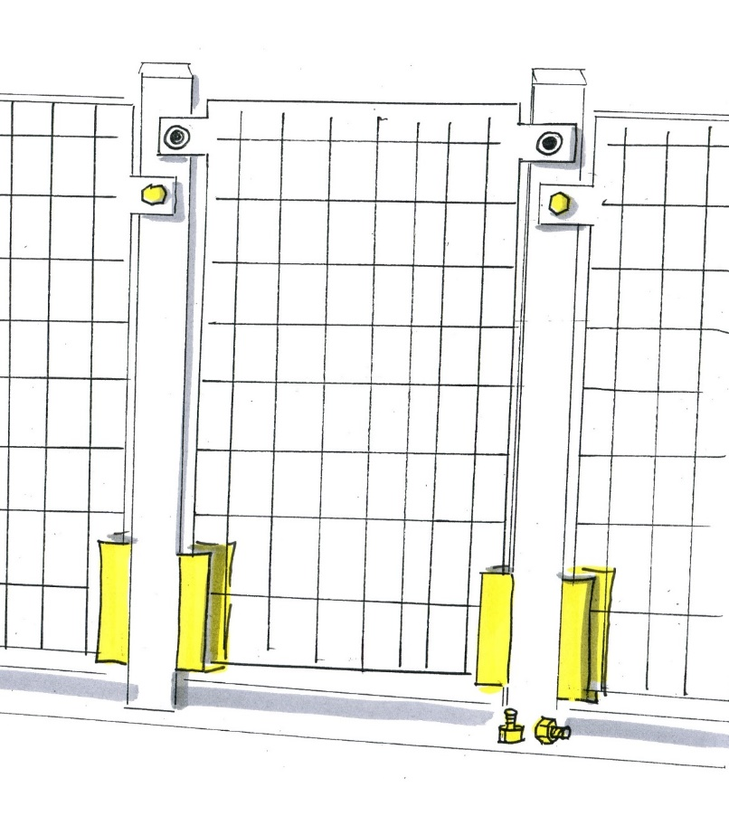
Detecting the defeating of protective equipment Example: fixed guards
For ease of installation, protective fences are often only inserted loosely at the bottom. The guard:
Remains in its safe position when the fixings have been released
Can be removed without a tool
Defeating of the protective equipment is not apparent
© Michael Hüter
Notes:
Problem:
Fixed guards are fitted that remain in the safe position even when their bolts are removed.
Example:
For ease of fitting, protective fences are often bolted into place at the top, but only inserted loose at the bottom. This becomes critical when release of the bolts leaves the guard in its safe position but enables it to be removed without a tool. The guard can then be removed by a single movement and replaced equally easily. Defeating of the protective function is thus not only easy, but also not immediately apparent, for example to superiors.

Slide 38
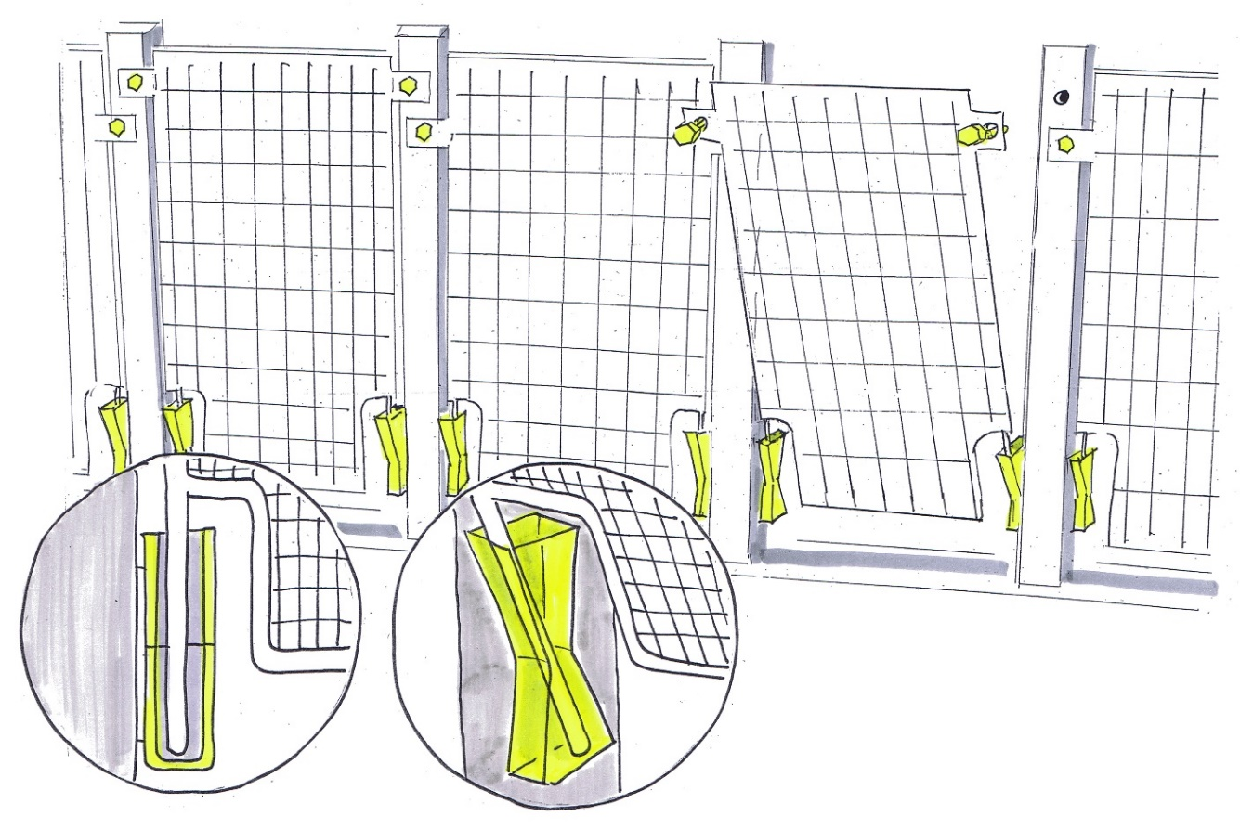
Solution A: special retaining brackets for protective fences
Use of special retaining brackets that cause the protective fence to depart from its safe position automatically when the fixings are released
Important: use captive fixings
© Michael Hüter
Notes:
Solution:
Use of special retaining elements that prevent the guard from remaining in the safe position when the bolts have been released.
Example A:
Special retaining elements cause the protective fence to tip automatically out of its safe position when the bolts are released. A guard that is not bolted into place can therefore be detected easily.
The use of captive bolts, which prevents their being lost, is also mandatory.

Slide 39
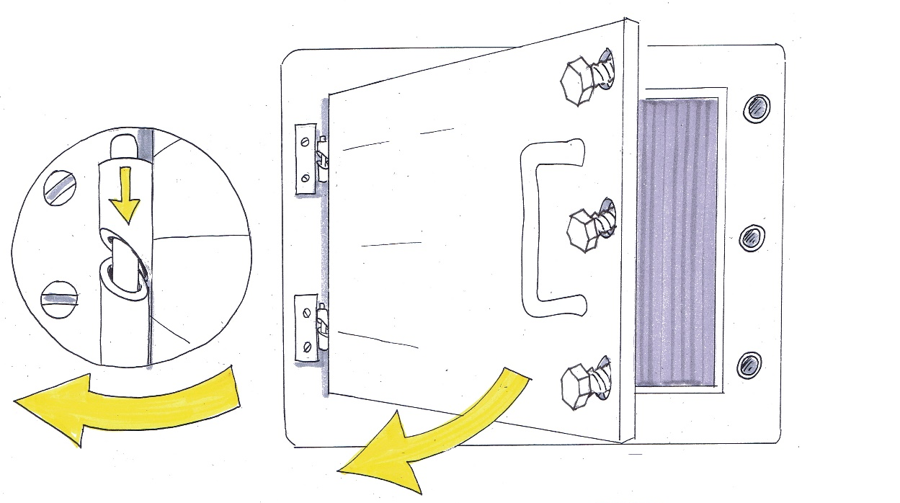
Solution B: gravity-operated hinges for maintenance doors
The angle of the hinge guide causes the maintenance door to depart automatically from its safe position should the fixings be released
Here too, captive fixings should be used
© Michael Hüter
Notes:
Example B:
The same applies to maintenance doors: if the door remains in the safe position when the bolts have been removed, it is not immediately apparent that it has been defeated. The use of gravity-operated hinges is a solution. In this solution, the angled hinge guide causes the door to swing open when the bolts are released. Doors that are not bolted in place are then readily apparent.
The use of captive fixings is also mandatory on maintenance doors.

Slide 40
We've saved the best till last
Installation
Purchase
Setting up
Sales
Opera- ting
STOP
Defeating the
Safeguards of Machines
Design
Trouble- shooting
www.stop-defeating.org
Defeating
© Michael Hüter
© Schmid Riedmann & Partner
Notes:
The "vicious circle of defeating". By use of as many of the strategies described here as possible at the design stage, which is one of the first links in the causal chain leading to defeating, the vicious circle can be broken.

Slide 41
Source:
German Social Accident Insurance
Preventing defeating of protective equipment on machinery
Tuition modules for accident prevention
Available online at: www.stop-defeating.org
(last modified on 12/03/2019)
Edited, modified or altered by:

